Slide 1
Medicines Information Promoting Pharmacovigilance to Radiographers
Claire King
Regional Medicines and Poisons Information Service, Belfast

Slide 2
Introduction
Patient Safety
WHO 3rd Global Patient Safety Challenge
Transforming medication safety in Northern Ireland
Yellow Card Scheme
MHRA pharmacovigilance tool
Under-reporting in Northern Ireland
Need to stimulate awareness and increase reporting
Opportunity
To promote pharmacovigilance, Yellow Card awareness and reporting to radiographers
Medicines Information well placed to do this.
No Yellow Card Centre in Northern Ireland.

Slide 3
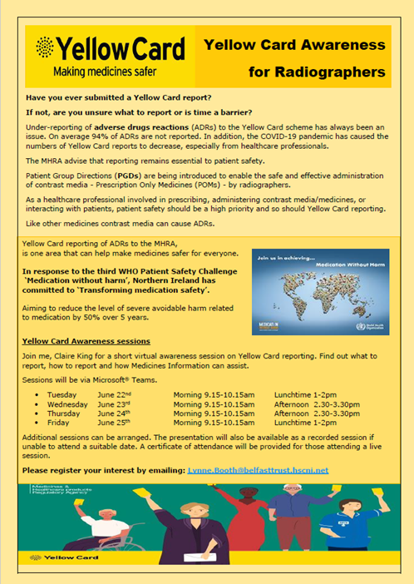
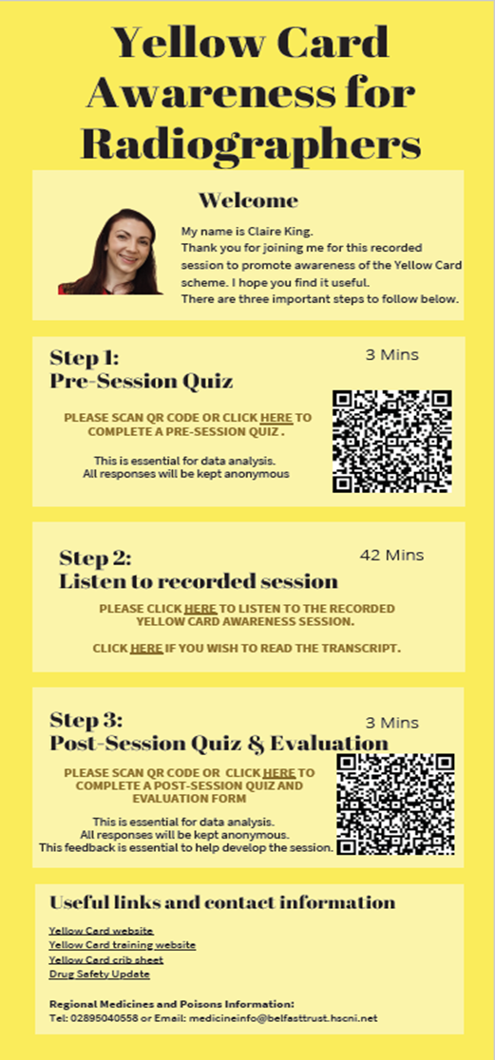
Promoting Pharmacovigilance
May 2021
Promotional flyer
June 2021
8 Yellow Card awareness sessions
One hour via Microsoft® Teams
Pre and post session quiz
Presentation tailored to radiographers
Live demonstration of YC website and Yellow Card app
Certificate of attendance
Recorded session available
Comparison
MHRA Yellow Card reporting figures Sept – Dec 2019 and 2021
Pre and post quiz scores

Slide 4
Radiographer Outcomes
Sessions
28 extremely useful
31 very useful
3 somewhat useful
“Excellent and interesting awareness session”
“Recommended
to a colleague”
“Learnt more than I thought I would”
“Very informative”
“Informative as knew nothing about the system previously”
“Really helpful in raising awareness”
Attended live session or viewed recording
Completed pre and post session quiz
Significant increase in mean quiz score
No increase in Yellow Card reports yet!

Slide 5
Discussion
Radiographers – enthusiastic and engaging
Limited by time constraints & staffing
Benefit of targeting specific groups or others working under PGD
Unable to facilitate training to all radiographers
Sparked interest from other niche professional groups - neuroscientists
Thank you to Belfast MI

Slide 6
Yellow Card Centre to launch 2023
Future
Monitor radiographer reporting 2023
Share project experience
Yellow Card education strategy to further promote Yellow Card scheme

