Slide 1
Medicines Information Training in the Virtual Classroom
Laura Granger and Maura Rogers
Royal Bournemouth Hospital

Slide 2
Background/Method
Before Covid19
1st week of pre-reg MI training delivered as group sessions in classroom environment.
During Covid19
1st week of training delivered via Microsoft Teams with trainees based at home and tutor at the hospital. Tutees on site for half a day.
Tutees then spend 2 weeks in MI answering real-life enquiries.
Training consists of self-directed learning plus tutor-led exercises.
Tutees then spend 2 weeks in MI answering real-life enquiries.
Timetable modified (content unchanged).
Tasks grouped into:
1. Self directed learning (at home)
2. Input from tutor (tutee at home)
3. Face to face teaching (on site)

Slide 3
Breakdown of the 1st Week
13%
26%
11%
73%
72%

Slide 4
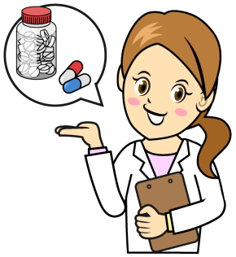
Expectations and feedback
Checking in using ‘chat’ function was quick and easy
Stress of room booking and I.T equipment removed
Alien concept – would it go to plan?
Enjoyable, organised, informative
Issues with internet signal
Pace of week instilled confidence/
understanding
Overall successful and went to plan
Good balance of presentations, face to face and self-directed learning
Would tutees be motivated at home?
Apprehensive about working from home
Virtual presentations worked much better than tutees all crowding around one computer.
Harder to check in – more planning required
Self-directed learning allowed for independent work at own pace
Tutor
Unsure what to expect
Tutees
Improvement suggestions: professional email writing task and more challenging telephone scenarios
Would tutees be engaged?
MLP/MiCAL repetitive however tasks broke them up
Tutees were motivated and engaged

Slide 5
Future Training
Advantages/limitations
Advantages - Using Teams without the camera can improve tutees’ phone skills.
Drivers for change
Hospital merger so delivering training to another site.
Increased number of trainee pharmacists this year (from 4 to 10).
Going forward
We propose the virtual classroom is a viable option for future cohorts of trainee pharmacists.
‘Breakout rooms’ could be used for smaller group work.
Sessions could be recorded to avoid duplication and aid time management.
This method could be used for other staff groups, and up-scaled to teach large groups.
More familiar with using teams, therefore improved confidence in providing training.
A virtual classroom reduces the need to travel between MI and a booked room.
Limitations – fewer resources accessible at home.
A lack of rooms to book so social distancing not possible.
Shortage of computers in the department.
MiDatabank trainer not available at home.

