Slide 1
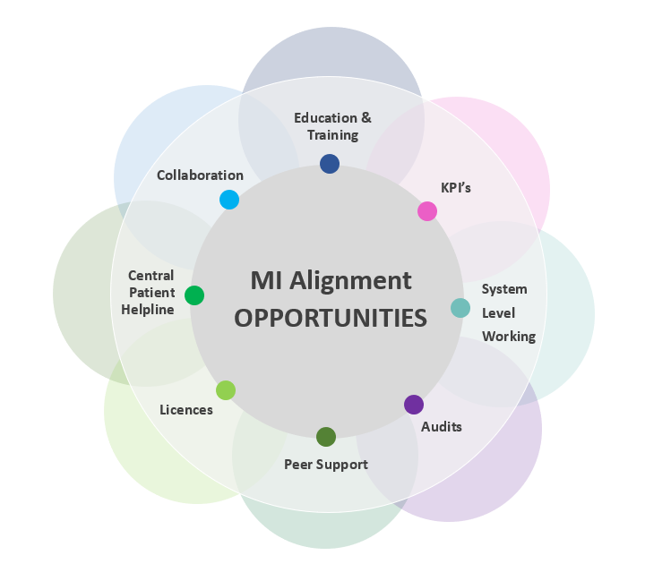
Collaboration and Alignment of MI across an Integrated Care Setting (ICS) – first steps Kirsty Habibi-Parker, Medicines Resource Centre, Buckinghamshire Healthcare NHS Trust, with the BOB ICS MI Alignment Workstream
MI QI:
Background and Introduction
Within the BOB ICS (Buckinghamshire, Oxfordshire and Berkshire West Integrated Care System) we have 3 acute trusts (Buckinghamshire Healthcare NHS Trust, Oxford University Hospitals Foundation NHS Trust and Royal Berkshire NHS Foundation Trust) and 2 mental health trusts (Oxford Health Foundation Trust and Berkshire NHS Foundation Trust) providing medicines information services, to a population of 1.8 million.
VISION: is to align our medicines information (MI) services across the ICS, and to quote SPS “do once well and share”. To scope our processes and develop these into a single unified process.
AIM: Transform our MI services into an integrated service at scale (ICS level) to support our workforce, collaborate and work on a united front to provide the highest standard of care to our patients and service users.
Method and Timeline
Workstream group established in order to scope what we need to do differently.
Develop best practices into a single unified process.
Initial ideas brainstormed.
Potential quick wins identified to build momentum with progress.
Action plan formulated to assign next steps and priorities.
1 year timeline to seek joint up approach to licences and implement initial changes
Longer term to align services, potential 5 year plan
Challenges
Current workforce climate – ensuring all parties can attend workshops
Providers unfamiliar with the definition of an ICS
Benefits
Joined up thinking in aligning our MI services at a systemic level within our ICS will provide a streamlined service to our services users and ultimately is better for our patients.
Following initial scoping of the potential areas which could be aligned across our services, we produced an action list and prioritised our goals.
Standardisation across our ICS patch will aid our workforce to provide the best service possible with the resources we have.
Our BOB MI group meets regularly to carry out our strategy.
We will also meet to share and discuss quantitative and qualitative metrics.
Case studies can be powerful stories.
We aim to add value to the service that we deliver.
Key Priorities
Training – share current practices, contribute to group updates and develop further. Propose to develop 10-15min sessions on You Tube, unlisted.
Peer Support – proposed trial between BHFT and BHT over 2023.
Workshop – F2F proposed and well attended. Further workshops planned to propose initial priorities of aligning, including 1 initial priority for each Trust.
Standardisation
Enquiries via email, not all Trusts have standard response.
Variation in format of user satisfaction surveys and collation of feedback.
Training – core and specialist.
Licencing: better pricing transparency from resource providers.
Learn from others: Welsh MI resources and access and NEWT role out, SPS, previous Trust’s experiences of approaching collaboration.
Future
Address key stakeholders
Aim to demonstrate efficiency and productivity benefits

