Slide 1
Implementing a single telephone number across the Midlands and East Medicines Advice Service
Anna Bischler, Vanessa Chapman, Mark Cheeseman, Sarah Fenner, Midlands and East Medicines Advice Service

Slide 2
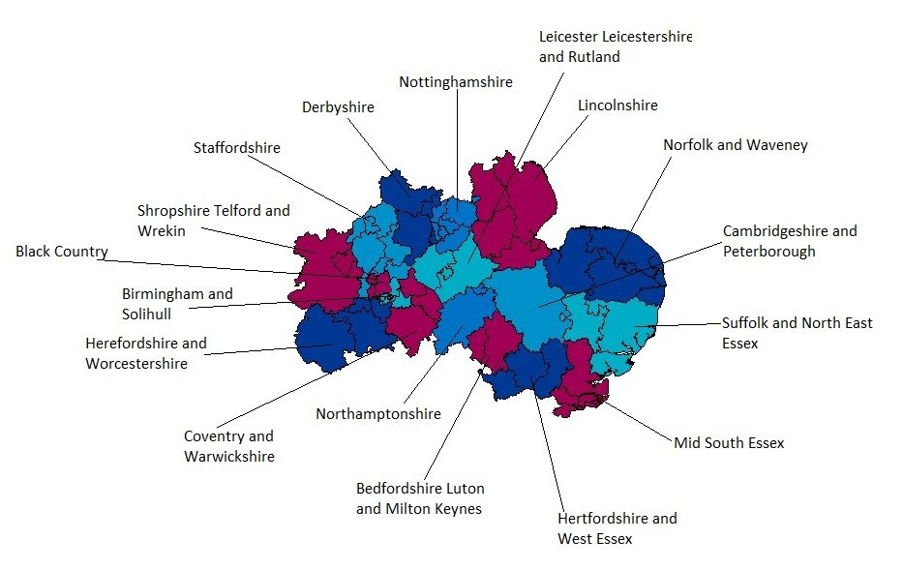
Caller’s STD code recognised and automatically routed to nearest geographical centre.
Caller phoning from mobile or STD code not recognised, presented with options menu.

Slide 3
From January to May 2021, the single number received 198 calls to the single number;
88% (n=174) received during service opening hours
Over half the calls (56%, n=97) originated from the West Midlands area, followed by East Anglia (20%, n=35) and East Midlands (16%, n=28).
A small number (8%, n=14 (range 1 – 6)) hung up during the selection menu
.

Slide 4
Having a single number has simplified the way healthcare professionals can access the service. Previously users were confused as to who could access which service, particularly during transfers of patient care across boundaries or staff movement. Introduction of a single number has made these issues disappear [MEMAS Manager]
[The single number was] very easy to use, straight through to centre and the call was answered very quickly; didn’t have to wait long.
[MEMAS User]
Following monitored throughout:
Incidents - nil
Complaints - nil
Enquirer (user) satisfaction – 100%
Responses within agreed timeframe – 99%
Staff feedback: huddles, 1:1s
Operationally, using a single number has made it much easier to direct calls from
the West Midlands to the site scheduled to receive those calls!
[MEMAS Team member]

Slide 5
Summary of outcomes and future implementation
This is the first time a single number has been successfully implemented across multiple MI sites within England
Majority of calls (90%) received during working hours.
Majority of calls originating from West Midlands (57%), followed by East Anglia (n=19%) and East Midlands (n=17%).
Small number (7%, n=19) hung up at initial welcome message.
User and service feedback remains positive.
Calls received via the MEMAS single number represents 36% of workload received via telephone.
Development of a stakeholder engagement and oversight group for MEMAS
Ambition to have a national rollout to improve access to MI services

