Slide 1
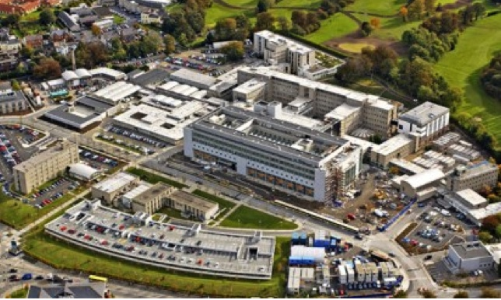
Managing a Myriad MI response to the COVID19 pandemic
Medicines Information Service,
Pharmacy Department

Slide 2
Focal points
Prioritisation of work – COVID/non COVID
Collaboration with Stakeholders
Managing information overload
Notes:
Collaboration with Stakeholders and prioritisation of COVID related tasks

Slide 3
