Slide 1
Information that is easy to swallow
Authors: Claire King and Paula King
Regional Medicines Information Belfast Northern Ireland
With acknowledgement to the Northern Ireland (Adult) Dysphagia Group particularly the Medication Task and Finish Group, Colin Harrison Pharmacist HSCNI Medicines Management Team, Karoline Brennan MI Pharmacist North West Medicines Information Centre and Lynne Booth Regional Medicines Information Belfast.
Notes:
I’m Claire King. Presenting ‘Information that is easy to swallow’

Slide 2
Background
Background
Swallow Aware
Project led by the Public Health Agency in Northern Ireland (website: http://pha.sit/Dysphagia) aimed to provide solutions to ten regional priorities and to create awareness of the impact of swallowing difficulties.
Key Priority
Dysphagia Friendly Medicines: raise awareness and support medication management guidelines.
Dysphagia (Adult) Regional Steering Group - June 2018
Multidisciplinary professionals
Focus groups – key issues
Remit: Oversee work plan and actions for change
Medication Task and Finish Group - July 2019
Review collated medication issues
Consider development of medication guidance
Additional information and knowledge gaps - use of thickening agents and thickening agents/medicines
Existing guidance highlighted:
“Medication for People who have Swallowing Difficulties” available from NI Formulary website:
https://niformulary.hscni.net/prescribing-newsletters/swallowing-difficulties/
Notes:
In Northern Ireland, a Swallow Aware project has been led by public health, to provide solutions to ten regional priorities and to create awareness of the impact of swallowing difficulties.
One of the ten regional priorities included Dysphagia friendly medicines to raise awareness of medication issues.
A Dysphagia regional steering group was established – multidisciplinary group with representation from Regional Medicines Information. A number of key issues identified around medication management through focus group feedback. The remit of the steering group was to oversee a work plan and actions for change on these key issues.
A Medication task and finish group reviewed collated medication issues, considered development of medication guidance and additional information to address knowledge gap regarding use of thickening agents and thickening agents with medicines.
Medicines information had already produced guidance in 2018, available on NI Formulary website – which was highlighted.

Slide 3
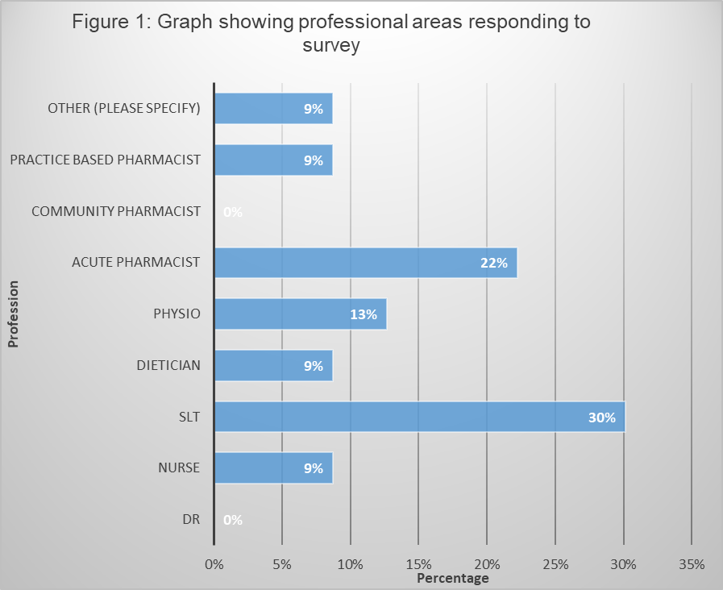
Actions Existing guidance
Actions
Multidisciplinary survey feedback on existing guidance
Medication Task and Finish Group
Conducted survey between Oct 2019 to Nov 2019 to address focus group medication issues.
Survey assessed awareness of existing guidance, potential value of this guidance and how to raise awareness. Any gaps in guidance?
Concluded existing guidance “Medication for People who have Swallowing Difficulties” addressed the majority of issues.
Multidisciplinary survey responders
Survey feedback
Not Aware
77%
Usefulness
91%
Raising Awareness
Newsletter
90%
Regional Medicines Information agreed to:
Liaise with HSCNI Medicines Management Team to raise profile of the “Swallowing Difficulties” guidance.
Notes:
The medication task and finish group conducted a survey to assess awareness of the current guidance.
The survey also gauged the potential value of the guidance, how to raise awareness and any gaps in the guidance.
- Multidisciplinary feedback – good response from primary and secondary care.
77% respondents had not previously been aware of the guidance
91% advised the guidance would be useful now they were aware of it
90% indicated that a signposting newsletter would be useful to raise awareness.
Medicines information agreed to liaise with HSCNI medicines management team to raise the profile of the “Swallowing Difficulties Guidance” on the NI Formulary website.

Slide 4
Actions UKMi Q&A documents
Actions
Additional Information
What is missing?
Knowledge gap regarding thickening agents and thickening of medications
FAQs
Do thickening agents interact with medicines?
Can thickening agents be prescribed?
How much thickening agent to prescribe for 1 month?
How to administer medicines to patients requiring thickened fluids?
Is it unlicensed to thicken medicines?
Are thickening agents medicines?
Regional Medicines Information agreed to:
Develop a Q&A style document to address local questions about the use of medicines and thickening agents.
UKMi dual purpose project:
Similar questions regarding the use of thickening agents with medications commonly arise across the UKMi Network. Liverpool had a similar issue.
Belfast-Liverpool collaborative working. Three national UKMi Q&As.
Addresses local issues with benefit to the UKMi network and avoiding duplication of effort.
Notes:
Information on thickening agents or thickening of medications was the most requested additional information – suggested by 9% of respondents, this had been identified by focus groups.
It was agreed to develop a Q&A style document to address local questions collated from survey feedback and enquiries received on MiDatabank, regarding the use of medicines and thickening agents.
Clear that similar question commonly arise across the UKMi network.
Discussion with Liverpool Mi colleagues confirmed they were also approached to produce guidance.
Belfast and Liverpool North West medicines information centres worked together to produce national information to avoid duplication of work. Led to a dual purpose project.

Slide 5
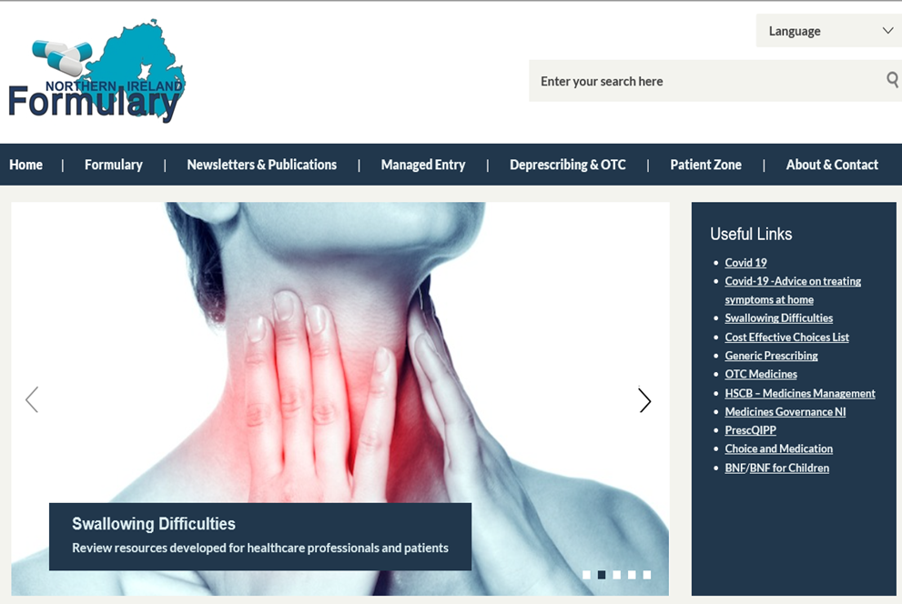
Outcomes
Outcomes
Existing guidance
Future 2020
NI Formulary Useful Links will be updated October 2020 to signpost to new UKMi Q&As on thickening agents.
Northern Ireland Health and Social Care Regional Dysphagia Newsletter (NI (Adult) Dysphagia group) is planned October 2020 to raise awareness of “Swallowing Difficulties” guidance.
“Swallowing Difficulties” Guidance prioritised within NI Formulary supported by a visual image for greater impact.
Notes:
The “ Swallowing Difficulties” guidance was prioritised within the NI Formulary website, by being listed as the 3rd topic in the useful links section supported by a visual image.
In October the useful links section will be further updated to signpost to the new UKMI Q&As and a Regional Dysphagia Newsletter is also planned to raise awareness.

Slide 6
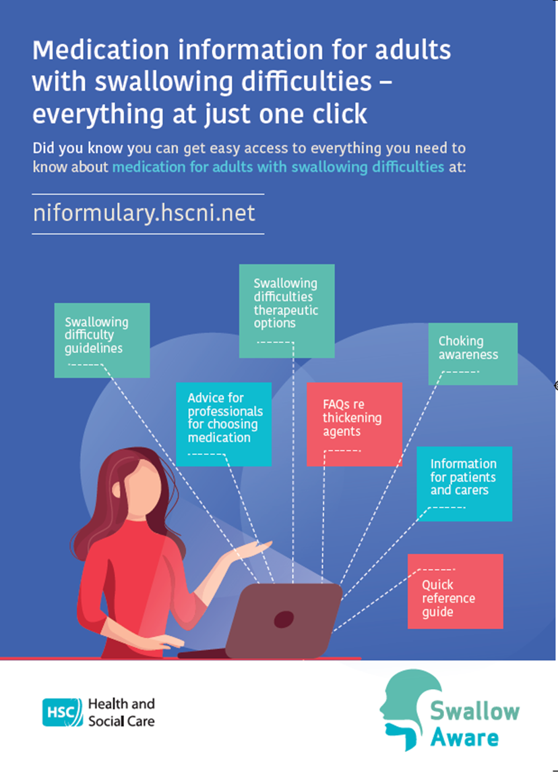
Outcomes
UKMi Q&A documents
Publication of Public Health Agency Poster.
Publication of three UKMi medicine Q&As on the SPS website September 2020 https://www.sps.nhs.uk/ to address local and national issues.
UKMi Medicines Q&A
Thickening agents: what to consider when choosing a product
UKMi Medicines Q&A
Thickening agents and thickened fluids: do they interact with medicines?
UKMi Medicines Q&A
How can patients who need thickened fluids take medicines?
Future
SPS web analytics September 2020 to September 2021
This will enable monitoring and review of national access to UKMi Q&As on thickening agents.
Provide feedback on the usefulness to the UKMi network.
Notes:
The main outcomes were publication of a Public Health Agency Poster which is displayed, and publication of three UKMi Q&A documents in September 2020 on the SPS website to address local and national issues.
Over the next year, SPS web analytics will enable monitoring and review o national access to these documents and provide feedback on their usefulness to the UKMi network.

