Slide 1
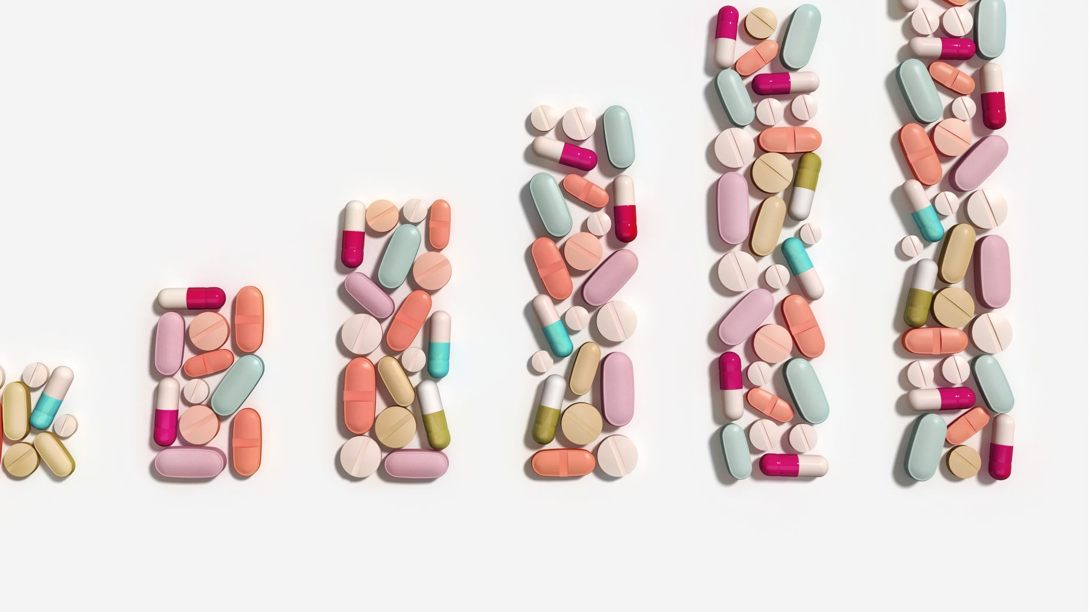
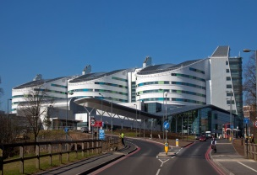
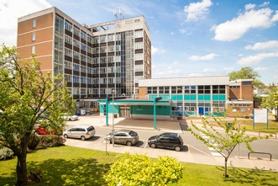
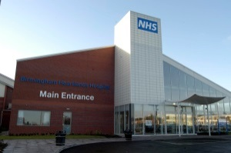
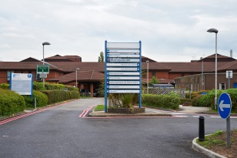
Analysis of ‘Inappropriate’ Medicines Helpline Calls and Identification of Strategies to Reduce Such Calls
Rishvana Mohamed – Senior Clinical Pharmacist Medicines Information

Slide 2
Introduction
Medicines Helpline
- Easily accessible service for patients following discharge
- Number printed on all discharge letters
- Patients / community healthcare professionals
Enquiry Numbers
Inappropriate Calls
- Time consuming
- Inefficient use of MI resources available
↑ 343.37%

Slide 3
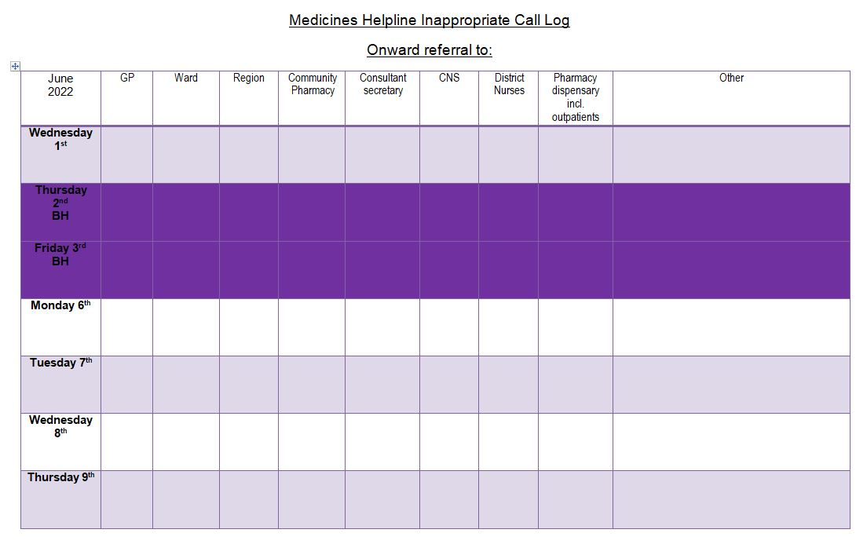
Method
Data collected over 2 months
Types of calls
categorised
Data analysed
Excel
Team meeting
Review of data

Slide 4
Results
Enquiries were directed to…
71
46
Notes:
General overview of traditional MI service.
Technicians and support staff.

Slide 5
Results
April 2022
June 2022
Notes:
General overview of traditional MI service.
Technicians and support staff.

Slide 6
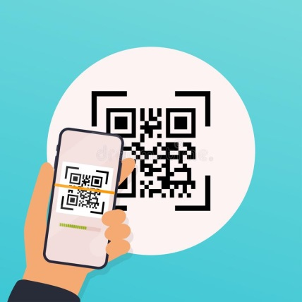
Outcome
Team-based discussion
Signposting document – Primary Care
Patient Information Leaflet
FAQ page – via QR code
Notes:
General overview of traditional MI service.
Technicians and support staff.

