Slide 1
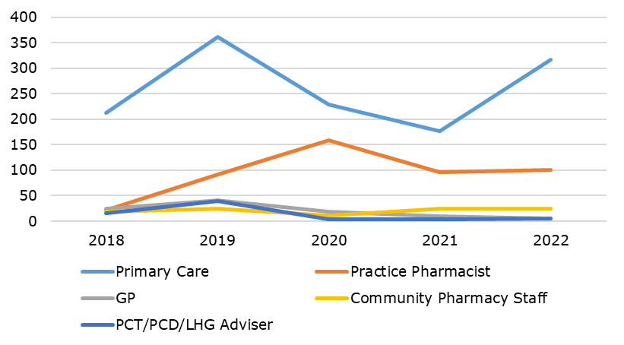
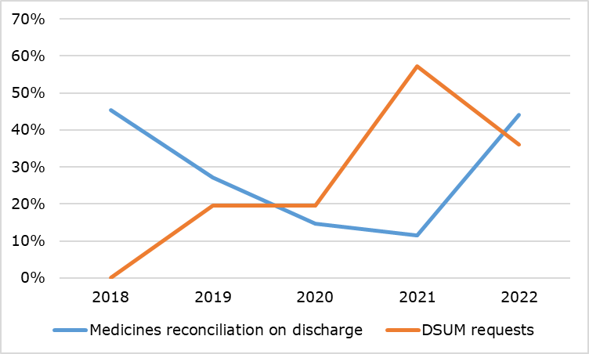
A 5-year retrospective review of enquiries received from primary care professionals
Thaaranii Rajkumar, Esther Wong, Joanna White, Chelsea and Westminster NHS Foundation Trust
Introduction
Chelsea and Westminster NHS Foundation Trust's Medicines Information (MI) service provides information to patients, healthcare professionals within the trust, and colleagues in primary care.
Over the past five years, the number of calls from primary care pharmacists has grown. A review was conducted to assess the types of calls received and the distribution between healthcare professionals.
It was felt beneficial to identify common trends in the nature of enquiries received to possibly implement ways to reduce the number of avoidable primary care enquiries.
Aims
To retrospectively review the number of enquiries received from primary care professionals and determine the type of enquiries that are commonly answered.
To implement ways to reduce the number of avoidable primary care enquiries to the Medicines Information service.
Method
Data was extracted from MiDatabank² retrospectively using the ‘Reporter’ function. Data was collected from 01/01/2018 to 31/12/2022. The data was entered on an excel spreadsheet³ and analysed.
The enquiries received from primary care professionals were subcategorised into enquirer type: GP, primary care pharmacist, community pharmacist and other healthcare services.
Fig 1: Total number of enquiries received over five-year period (2018-2022).
Results
Between 2018 and 2022, 34% (n = 5982) of all calls received were from primary care healthcare providers, of which 23% (n = 2032) calls were from primary care pharmacists/technicians. There is a 17% increase in enquiries received from primary care during this five-year period in which the biggest increase was seen within enquiries received from practice pharmacists. In 2018, only 3% of the enquiries were received from practice pharmacists compared to 11% received in 2022.
Enquiries relating to medicines reconciliation on discharge made up the majority of the enquiries received from practice pharmacists; this has increased from 28 enquiries in 2018 to 54 in 2022. There is also a steady increase of discharge summary (DSUM) requests from practice pharmacists during the years 2018 to 2022 however this then declined in 2022 (Fig 2). Enquiries received directly from GPs decreased from 8% of total enquiries in 2018 to 1% in 2022.
Fig 2: Query types from practice pharmacists over five-year period (2018-2022).
Discussion
During the five-year period captured within the audit data collection, 34% of all enquiries received were from practice care professionals (PCPs). PCPs therefore make a significant contribution to the total number of enquiries received.
Furthermore, a substantial increase was noted in the percentage of enquiries received from PCPs from 2018 to 2022, with a total increase of 17%. A significant increase has also been identified in the number of enquiries received from clinical pharmacists working in primary care. This coincides with the introduction of the five-year GP Contract Framework in 2019, which guaranteed funding for up to 20,000 additional staff, including clinical pharmacists. This will free up GPs to spend more time with patient who need them¹.
The results indicated that the most prevalent type of enquiry related to medicines reconciliation at discharge; making up 24% of all primary care pharmacists enquiries between 2018 and 2022. This accounts for a significant portion of the work complete by MI and therefore highlights a key area in need of improvement to reduce unnecessary workload.
Recommendations
The following changes to current practice should be made to improve the quality of discharge, as many medication errors can result from a lack of effective communication between healthcare providers and primary care:
All discharge summaries should have clear documentation (medicines reconciliation) for primary care professionals, improving secondary and primary care communication. This can be fed back to the Pharmacy department via the departmental weekly meeting. Additionally a concise bulletin should be created providing top tips on how to improve documentation at discharge, which will be disseminated across the Trust.
Primary care leads will provide training on PharmOutcomes. PharmOutcomes is a secure platform that allows community pharmacies to access clinical documents from secondary care, including discharge summaries. Utilising this effectively will streamline medicines reconciliation in primary care, as PCPs do not need to contact MI in order to request relevant documentation.
All missing information or errors on discharge summaries should be reported via Datix to identify learning and implement improvement. This is so that, through collaborative learning and continuous development, we can make healthcare safer for both patients and staff.
References
¹NHS England» Five-year deal to expand GP services and kick start NHS Long Term Plan implementation [Internet]. www.england.nhs.uk. 2019. Available from: https://www.england.nhs.uk/2019/01/five-year-deal-to-expand-gp-services-and-kick-start-nhs-long-term-plan-implementation/
²COACS. MiDatabank Enquiry Manager v3.2.
³Microsoft 365. Microsoft Excel Spreadsheet Software 97-2003

