Slide 1
The Accredited Medicines Information Technician Training Scheme (AMITTS) Current picture, changes and future opportunities
Ellen Williams, Director of Regional Pharmacy Training
Kate Postle, Regional accreditations Training Programme Director

Slide 2
Overview of the session
Summary of the plans for PWDS to deliver the UKMI Accredited Medicines Information Technician Training Scheme (AMITTS) from Dec 22
Insight into the vision for the development of a new course
Next steps for the existing programme including:
the enrolment process for those on the waiting list
what the changes mean for currently AMITTS accredited pharmacy technicians

Slide 3
Background
Current picture
Why change?
Risks/benefits

Slide 4
About PWDS?
Who are PWDS?
What do we do?
All Programmes - PWDS
What are the benefits of PWDS delivering the programme?

Slide 5
What happens next?
MoU agreed between PWDS and UKMI – programme will co-branded
PWDS to transfer existing programme and begin enrolments onto current course format as of 1st Dec 22
PWDS to begin a comprehensive review and development of the programme in 2023, with full collaboration and consultation with UKMI

Slide 6
Next AMITTS intake
Plan for a smooth transition to PWDS delivery
Pharmacy technicians currently on the waiting list to be invited to enrol on the current programme in Dec 22
12 month training programme
VQManager to continue as e-portfolio platform
First online induction - Feb 23
Regular online touch points and practice development days to be facilitated throughout the course

Slide 7
Future developments
Opportunities to develop programme
Align with developments in education standards for pharmacy professionals and other medicines optimisation training programmes
Widen access to other pharmacy professionals and healthcare professionals responsible for answering medicines related queries
Ensure scope of the programme learning outcomes are relevant to all sectors
Review levels of practice – does the programme need to reflect these
Review the reaccreditation requirement
Review the role of Educational Supervisors (ES) and enable AMITTS accredited pharmacy technicians to act as ES’s

Slide 8
Recognition of prior learning
Grandparenting of AMITTS accredited pharmacy technicians
Plan to maintain the register of AMITTS accredited pharmacy technicians
Process to be developed to recognise the prior learning and accreditation of pharmacy technicians that have previously completed AMITTS
Both accreditation and experience to be recognised

Slide 9
Summary
Exciting opportunity to develop and expand the popular and trusted UKMI AMITTS
Plans for a smooth transition in the short term to accommodate the training needs of those pharmacy technicians awaiting enrolment
Experience and accreditation of pharmacy technicians who have previously been accredited to be recognised

Slide 10
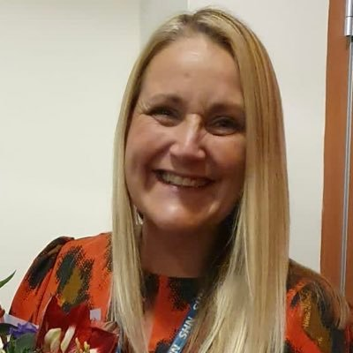
Any questions?
Contact:
Ellen Williams
Ellen.williams@nhs.net
Kate Postle
Kate.postle@nhs.net

