Slide 1
48th UK Medicines Information Annual Conference 2022 @UKMedicinesInfo #UKMIconference2022

Slide 2
Hywel Dda Medicines Advice Team 2021, Withybush General Hospital, Haverfordwest

Slide 3
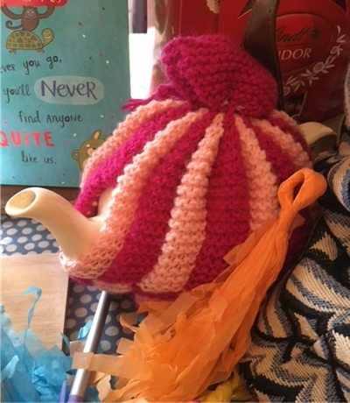
“The very act of preparing and serving tea encourages conversation. The little spaces in time created by tea time rituals call out to be filled with conversation. Even the tea itself-warm and comforting-inspires a feeling of relaxation and trust that fosters shared confidences” – Emilie Barnes

Slide 4
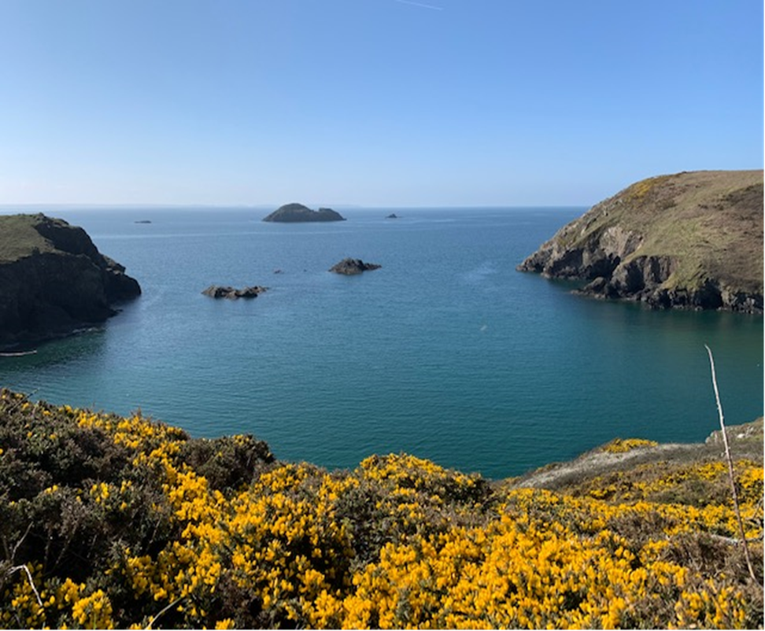
St. Elvis, Solva, Pembrokeshire Coast National Park

Slide 5
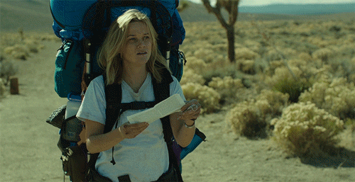

Slide 6
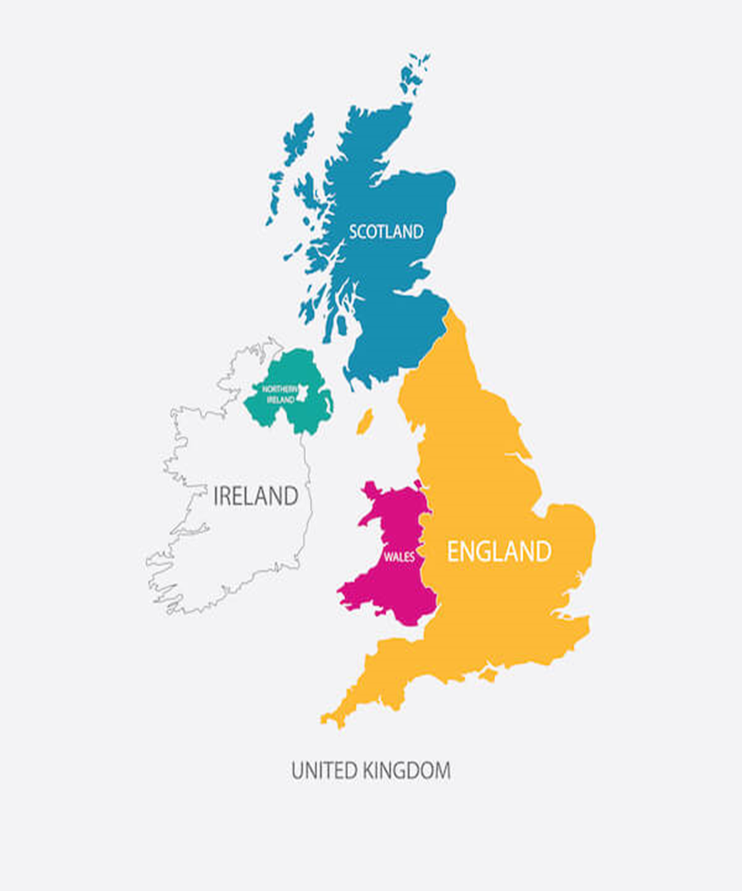

Slide 7
Mission for UKMi - Promote expert practice in medicines advice for all
Achieved through:
Education
Communication
Supporting audit
Research and innovation
Executive committee will:
Co-ordinate and provide leadership to network
Review membership
Deliver objectives – professional standards, infrastructure for network, access to training, supporting national pieces of work, advisory role

Slide 8
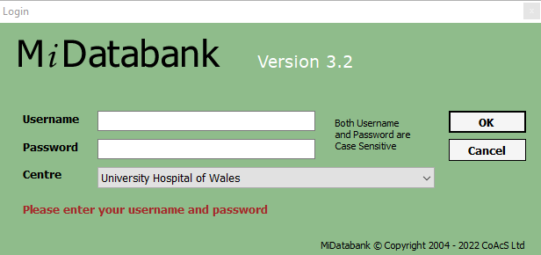

Slide 9
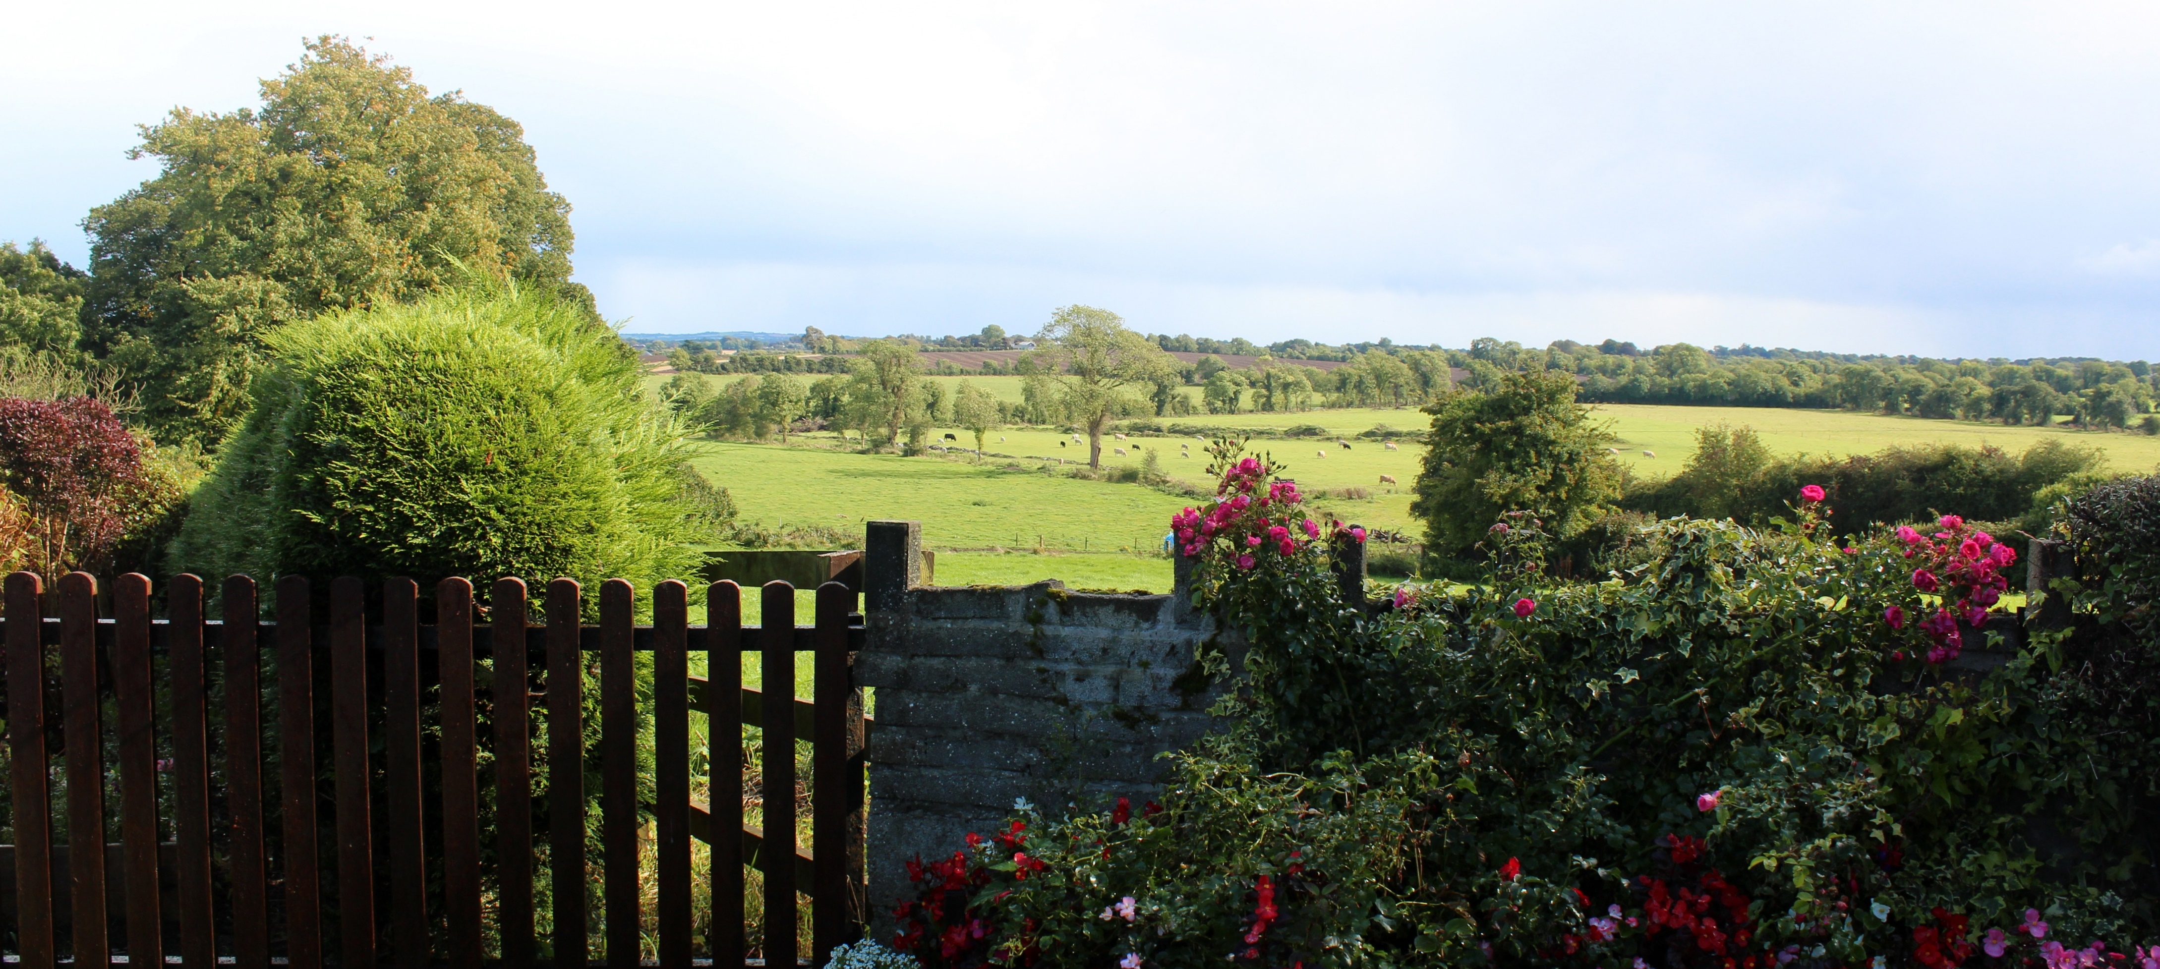
Medicines Advice Update - England
This Photo by Unknown Author is licensed under CC BY-NC-ND
This Photo by Unknown Author is licensed under CC BY-NC-ND
This Photo by Unknown Author is licensed under CC BY

Slide 10
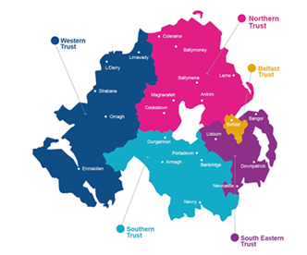
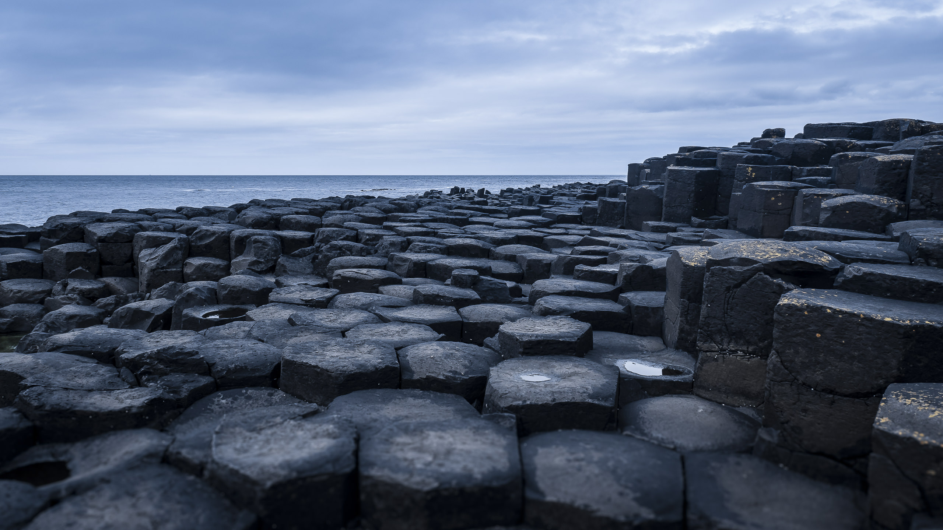
Medicines Advice Update - Northern Ireland

Slide 11
Medicines Advice Update - Scotland
This Photo by Unknown Author is licensed under CC BY

Slide 12
Medicines Advice Update - Wales

Slide 13
And the winners are…………..

