Slide 1
University Hospital Southampton (UHS) Medicines Helpline:
Improving patient engagement and experience
Angela Badiani and Mairead O’Grady, Southampton Medicines Advice Service, University Hospital Southampton NHS Foundation Trust and Dr Matthew Jones, Department of Pharmacy & Pharmacology, University of Bath

Slide 2
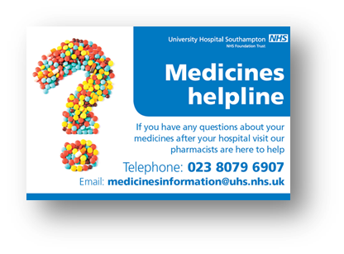
Introduction
Many NHS hospital pharmacy or medicine information departments provide a medicine helpline for their patients
The UHS Southampton Medicines Advice Service (SMAS) launched its Medicines Helpline in 2011
On average, it helps over 140 UHS patients and carers each month with a range of medication-related concerns.
The current user survey is based on what UHS expect patients would find important about the service.
There is little known about the service needs and expectations of patients/carers or how best to promote this services to users.
The aim of this study was to explore patient and carers’ priorities for the UHS Medicines Helpline and establish the most effective promotional strategies in accordance with their needs and expectations.

Slide 3
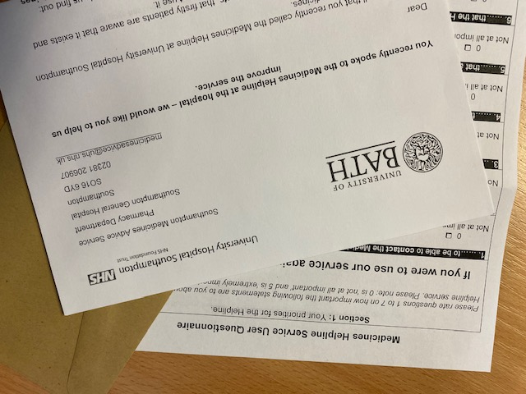
Method
Study protocol was developed
Approved by University of Bath Research Ethics Approval Committee for Health (REACH)
Questionnaire designed, peer-reviewed and piloted
A list of helpline callers ( over 3 month period) was generated from MiDatabank
169 service users met the criteria and were posted a pre-piloted self-completion questionnaire
Analysis
75 completed questionnaires were returned (44%)
Data were electronically transcribed into Microsoft Excel
Transcription was second checked
Then coded and transferred to an IBM SPSS® Statistics database for quantitative analysis

Slide 4
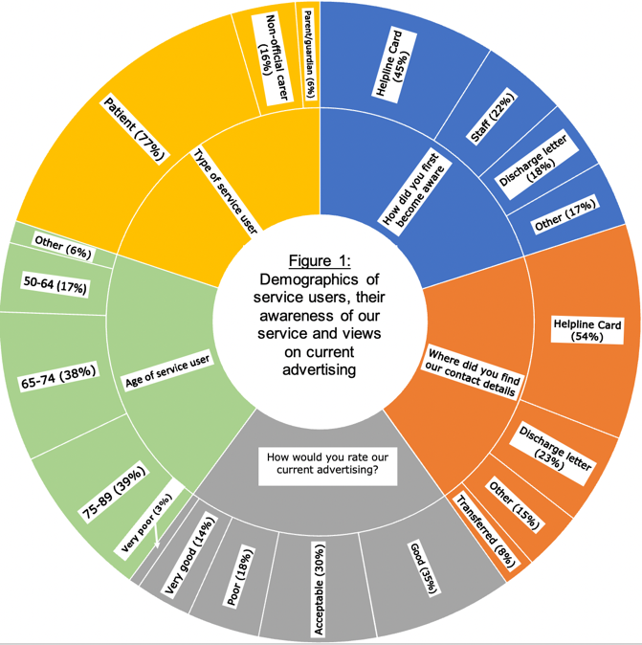
Results
If you were to use our service again, how important is it to you… | % (n=75)
to be able to contact the Medicines Helpline easily? | 74.7%
that the Helpline staff understand your needs correctly? | 88.0%
that Helpline staff agree to get back to you at a time that is convenient for you? | 57.3%
that Helpline staff get back to you on time? | 58.7%
that the advice given by the Helpline staff is helpful? | 77.3%
that the Helpline staff give you enough information? | 80.0%
to be confident in the answer/advice the Helpline staff give you? | 81.3%
Table 1: Percentage of services users that rated the following priorities as ‘extremely important’ were they to use the service again.

Slide 5
Discussion and Conclusion
Service users report the importance of helpline staff being able to understand their query, and provide them with helpful advice and sufficient information.
They also need to feel confident in the answer/advice the service provides.
Promotional improvements are still needed; despite the majority of users being satisfied with the current advertisement, 21% of users describing advertising as poor or very poor (n=75).
Future qualitative work will explore potential ‘new’ service users’ views in the form of semi-structured interviews in order to ‘triangulate’ the quantitative data from this study. The current user survey and promotional methods will be revised accordingly.
This study has helped to identify local service user needs of the UHS Medicines Helpline and the need for improvements to be made on existing promotional strategies

