Slide 1
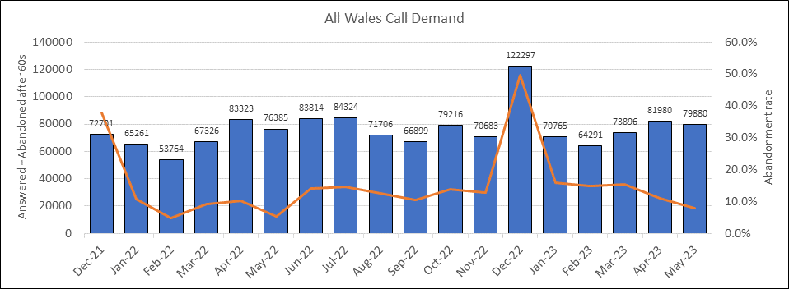
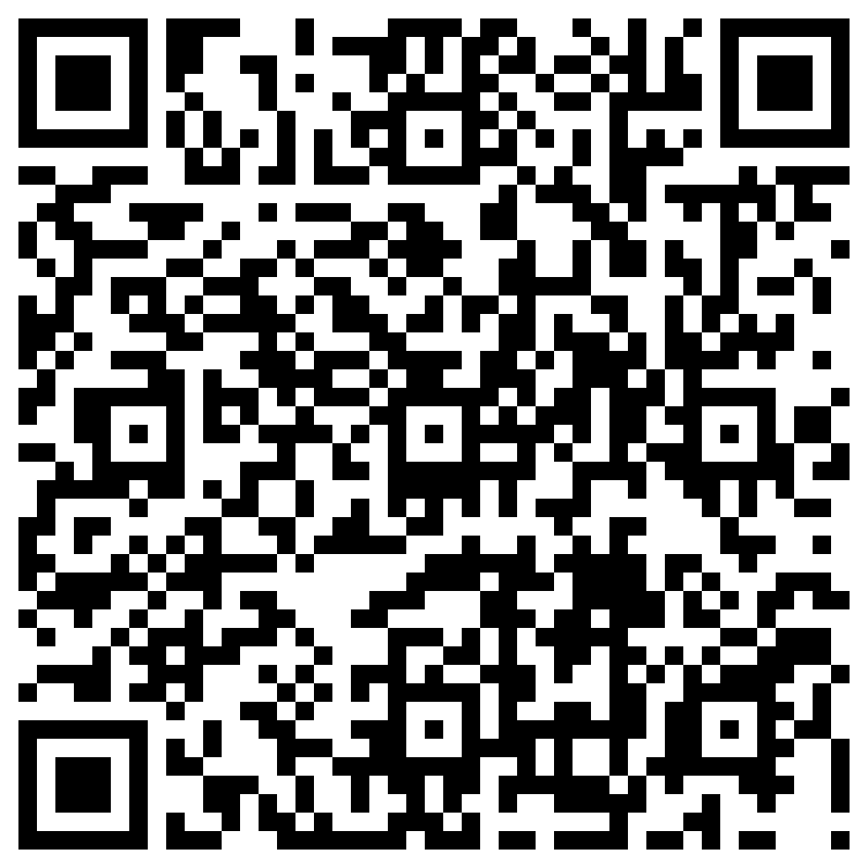
The Group A Strep Demand in Wales 2022-23 How the Welsh Medicines Advice Service responded
Authors: Alex Bailey, Dianne Burnett, Lindsay Davies, Christina Fowler; WMAS Cardiff and Vale University Health Board.
Charlotte Hay, Charlotte Storer; WMAS Betsi Cadwaladr University Health board.
Background
WMAS is a Wales wide team of medicines information (MI) experts working together, to provide medicines advice and information for NHS Wales. One of the objectives of WMAS is to provide advice about the safe and effective use of medicines to health care professionals and their patients "Once for Wales". The Group A streptococcal disease outbreak in Wales provided WMAS with an opportunity to demonstrate this cohesive team approach.
Problem
Media reports of increases in Scarlet fever and invasive Group A streptococcal (iGAS) disease
High demand for assessment and treatment
Increased pressure to supply antibiotics
Demand for antibiotics exceeded usual levels
Supply-chain mechanism insufficient to cope
Patients presenting in multiple pharmacies
Prescription changes needed or multiple prescriptions issued
Figure 1: NHS111 Wales call demand 2021-2023
Approach
WMAS updated the national Sore Throat Test and Treat clinical framework to include WMAS resources for antibiotic choices and additional guidance
Intelligence from Community Pharmacy and procurement teams guided resources needed for antibiotic choice considerations for liquid or solid forms, and advice for patients
WMAS included in multi-agency meetings twice a week with WG, PHW, LHBs, NHS111Wales, AWTTC and Shared Services.
WMAS worked with PHW to issue additional prescribing guidance for current iGAS and Scarlet Fever treatment in Wales
Connect
Communicate
Collaborate
Consolidate
Solution
Develop new guidance
Write patient information leaflets
Update existing documentation
Create new PGDs
Information for Health Care Professionals
The responsive and effective outputs from WMAS has raised their profile in NHS Wales, while delivering key UKMi objectives:
Advising health care professionals
Optimising treatments
Implementing national guidance
Supporting patients
Delivering a proactive responsive service
Information for Patients

