Slide 1
Medicines Information Support for ICCU during COVID-19
Judith Morey, Medicines Information Lead
Jane Lewis, Principal Pharmacist, Critical Care Services

Slide 2
Background
During the COVID-19 outbreak the Trust redeployed many nurses to unfamiliar areas such as ICCU
These nurses were not only working
in an unfamiliar environment,
with unfamiliar colleagues,
in unfamiliar protective equipment
but many of the drugs were unfamiliar too.

Slide 3
The request
Medicines Information was approached to produce
quick reference guides
that could be:
readily accessible without the need to access technology,
easily readable and
complied with Infection Prevention practices.

Slide 4
Medicines Information’s response
Mi produced 35 monographs,
added to with the RECOVERY and REMAP-CAP trials and expanded access REMDESIVIR , that were A4 laminated sheets that could be:
held at the bedside;
wiped clean; and
readily accessible to staff.

Slide 5
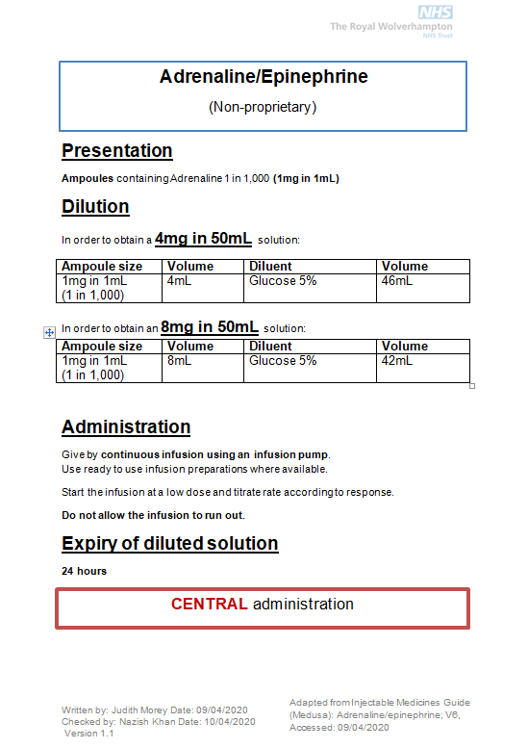
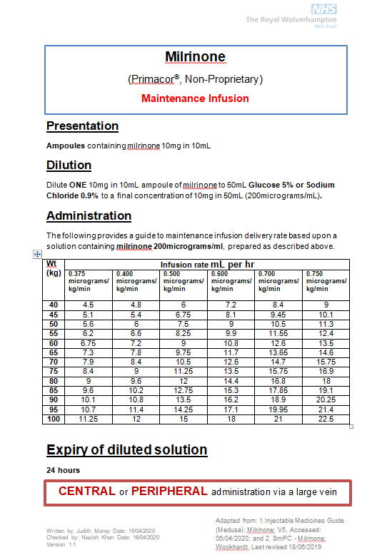
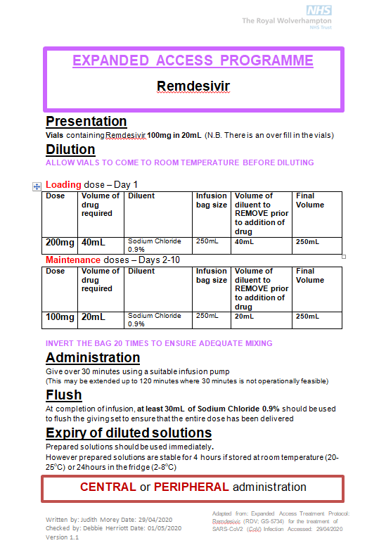
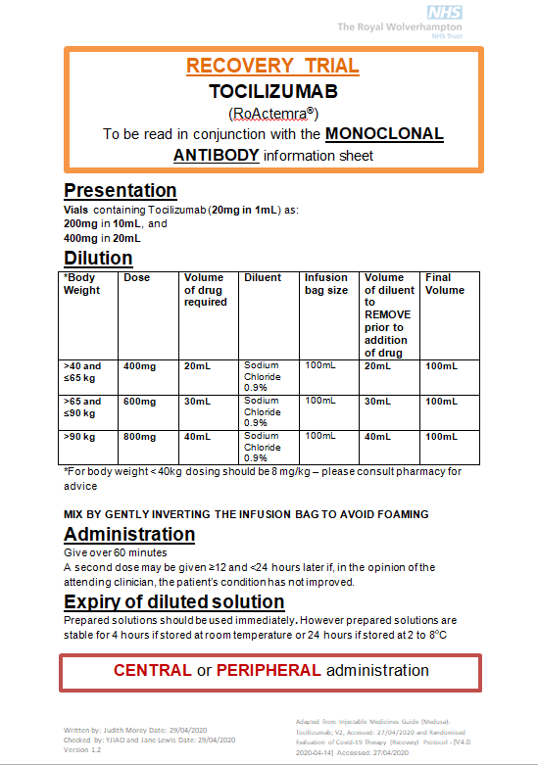
Feedback and the Future
The monographs were embraced very quickly, supporting the less familiar staff and freeing up the experienced ICCU nurses as all members of the team were willing and able to prepare drugs that they previously had no experience of using.
The monographs have been included in the #nogoingback campaign by the Trust to continue the positive changes made during the COVID-19 pandemic

