Slide 1
Barts Health Medicines Information COVID-19 updates - Brief analysis of a nationally provided one-stop information service
Authors: Bassi Sª, Olie C, Begum R, Woodlock K, Robert-Edomi Y, Onatade R
ª sukhpreet.bassi@nhs.net
Introduction
Barts Health is a multi-site hospital trust in East London. The Medicines Information (MI) department is based at a single site.
During the COVID-19 pandemic, large quantities of guidance (clinical and operational) were released from various professional and government bodies on a scale not seen before in recent times. Guidance were often produced at pace, with continuous updates as knowledge of the COVID-19 viruses developed.
Novel solutions were required to ensure that all pharmacy staff were kept abreast of vital guidance in a timely manner.
The MI team developed a one-stop COVID-19 Information service, with all guidance kept in a one-stop online hub arranged in order of specialty and disseminated daily.
Through promotion via networks and social platforms, the service gained national attention, with pharmacy colleagues across the country requesting access to the service.
At the height of the pandemic, the service provided summaries of COVID-19 information and guidelines, via daily emails to 70 healthcare organisations across the country.
The purpose of this study was to provide a brief evaluation of the service.
Aims
Evaluate the one-stop information service using the Stufflebeam CIPP evaluation model¹.
Reflect on potential improvements to the service.
The analysis was performed using the Stufflebeam CIPP model of evaluation under four key domains: Context; Inputs; Process and Product¹.
The service aims were also evaluated.
Notes:
Audio
Background
Due to the sudden on set and novel nature of the COVID-19 pandemic, as a nation we experienced vast quantities of information being released on how to manage the virus from various governing bodies, regulatory bodies, healthcare organisations and many more authorities. As the pandemic rapidly progressed and our knowledge of the virus developed, the information being released constantly increased, evolved, and changed. We found ourselves in a situation where it was difficult to identify the most accurate, relevant and up-to-date information on the management of the virus.
The Chief Pharmacist for Barts Health NHS Trust identified this as a significant risk to patient care and patient safety. To mitigate this risk we developed the Barts Health NHS Trust Medicine Information COVID-19 Update Service. This service acted as a one-stop information control and regulation centre, that reviewed, refined, summarised and communicated all the latest COVID-19 information and guidance. Though a number of networks and social platforms our service expanded to support over 50 healthcare organisations over the UK.
Service Aims and Objectives
The aims and objectives of the service were defined using various models and can be found on this slide.

Slide 2
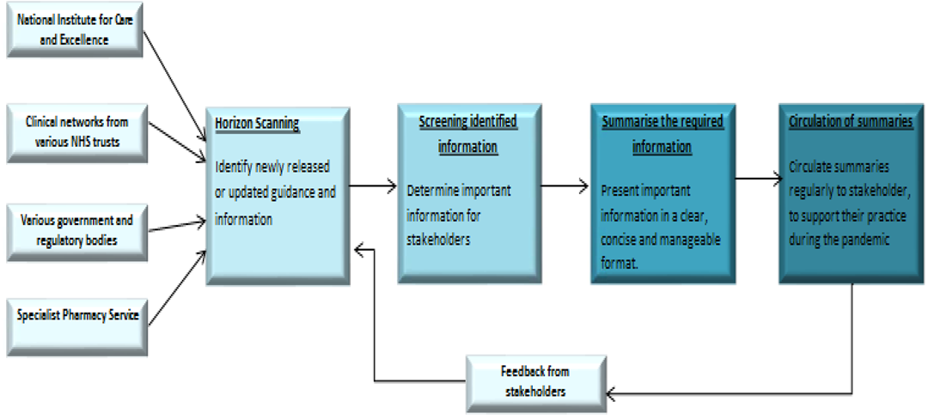
Service Aims
The MI COVID-19 Information Service will as act one-stop information hub; reviewing, refining, summarising and communicating, all relevant COVID-19 clinical information released during the pandemic. This will be provided daily to all service users via email.
To support and empower users by ensuring all clinical and operational activities are supported with up to date COVID-19 guidance.
Production of the daily updates
Input
Product
Notes:
Audio
Background
Due to the sudden on set and novel nature of the COVID-19 pandemic, as a nation we experienced vast quantities of information being released on how to manage the virus from various governing bodies, regulatory bodies, healthcare organisations and many more authorities. As the pandemic rapidly progressed and our knowledge of the virus developed, the information being released constantly increased, evolved, and changed. We found ourselves in a situation where it was difficult to identify the most accurate, relevant and up-to-date information on the management of the virus.
The Chief Pharmacist for Barts Health NHS Trust identified this as a significant risk to patient care and patient safety. To mitigate this risk we developed the Barts Health NHS Trust Medicine Information COVID-19 Update Service. This service acted as a one-stop information control and regulation centre, that reviewed, refined, summarised and communicated all the latest COVID-19 information and guidance. Though a number of networks and social platforms our service expanded to support over 50 healthcare organisations over the UK.
Service Aims and Objectives
The aims and objectives of the service were defined using various models and can be found on this slide.

Slide 3
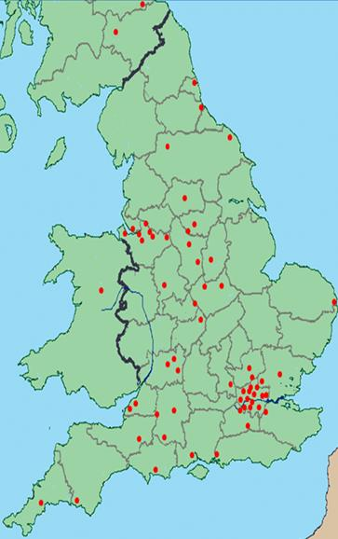
Results of the evaluation
Context
The service successfully delivered its aim of providing daily COVID-19 information and guideline summaries to pharmacy colleagues from over 70 healthcare organisations across the country.
Organisations receiving the updates included Private, NHS, Care homes, London Procurement, SPS.
Daily updates were disseminated for 51 days, after which the frequency of the daily updates was titrated down as the pandemic progression slowed.
Stakeholders were able to engage and input into the service via surveys and direct communication.
Feedback from stakeholders has been largely positive, highlighting the usefulness of the summaries during the COVID-19 pandemic.
The feedback also highlighted the following areas of improvement:
the need to reduce the amount of information shared with users
need to simplify the structure of the COVID-19 summaries through the use hyperlinks to direct the user.
Image 1: Map highlighting the locations of all organisations using the Bart's Health NHS Trust Medicine Information COVID-19 Update Service
Service Analysis
Input
The process of liaising with stakeholders and horizon scanning enabled the capture of key vital information once published. However due to the sheer volume of information released by the various bodies some information might have been missed or not detected in a timely manner.
Due to the demanding nature of the service and staff shortages caused by the pandemic, an increase in the workforce was warranted. This was achieved by utilising redeployed and shielding staff members..
Notes:
Audio
To achieve our aims, we adopted the following process:
Daily horizon scanning was conducted, where we reviewed all the newly released information.
This information was then refined using a screening process that identified the important information our stakeholders required.
We proceeded to reconfigure this information to produce refined summaries, presenting our stakeholders with the essential information in a concise format.
After extracting and summarising the important information, this information was emailed to stakeholders on a daily basis.
Service Analysis
Upon de-escalation of the first serge in the COVID-19 pandemic, we were able to conduct an analysis of our service.
When analysing the service in regards to the context is was conducted in:
A potential threat to the service was limited experience of the staff conducting the service and staff shortages due to the pandemic. In practice the service successfully overcame this barrier effectively.
Time was another treat to the service. Time was very restricted during this project, due to the sheer quantity of information being released and the stakeholders need for updated information.
Communication was a strength of the service. The service was very accessible to stakeholders and open lines of communication were encouraged. Allowing us to adapt the service to needs our stakeholders, via the feedback we received.

Slide 4
Service Analysis
Process
Horizon scanning and close working relations with an array of healthcare organisations ensured continued access to all the latest COVID-19 information.
However, due to time restrictions, collaboration with the clinical pharmacy teams to produce the summaries was not always possible.
To maintain the quality of the information disseminated, a two-person check process was adopted. The negative impact of this was a reduction in the content available to be produced and sent out to users.
Product
The service strategy to review, refine and summarise complex COVID-19 information was extremely successful, receiving a large quantity of positive feedback from stakeholders.
The service was adapted regularly in line with feedback from both internal and external stakeholders, the progression of the pandemic and internal reviews. For example, changes were made to the frequency, structure and content of the summary pages following feedback from users..
Conclusion
The Bart's Health NHS Trust Medicines Information COVID-19 update service successfully achieved the identified service objectives.
The team responded rapidly to the COVID-19 pandemic and worked cohesively to produce a consistent service.
More in-depth analysis is required to examine how the service met the needs of users.
The service is currently on pause whilst improvements are being made. Changes will be tested with stakeholders before re-launch.
Reference
D.Stufflebeam. The CIPP Model for Evaluation. International Handbook of Educational Evaluation. Vol 9. 31-62. Online. Accessed:14/08/20. [Available:https://link.springer.com/chapter/10.1007/978-94-010-0309-4_4]
Notes:
Audio
Input
Upon development of our service, we were unable to identify existing models or services to base ours on. This identified an opportunity for our service.
Time restrictions resulted in the service not always being able to collaborate with clinical services teams to produce our summaries.
Process
A strength of our service was the quality of the summaries and emails we produced. We ensure a high quality of work throughout our service by adopting a 2 fold checking process.
Service
Our service received positive feedback, from a trust-wide internal feedback session that discussed the management of the first surge of the COVID-19 pandemic. We also received positive feedback, via email, from a number of external stakeholders. Areas of improvement were highlighted and we are currently reviewing our service to improve in these areas.
Our service was able to meet the service objectives set as:
Our service empowered stakeholders to ensure their knowledge of COVID-19 guidelines, recommendations and information was kept up-to-date. Allowing their practice to reflect the gold-standard outlined by various governing bodies. This ensured the continuity in patient care and safety under unprecedented pressures.
And throughout our service, we have been able to support, empower and provide reassurance to our stakeholders.

