Slide 1
Medicines & Sustainability
Caroline Dalton
Lead Pharmacist Medicines Information,
Great Ormond Street Hospital

Slide 2
agenda
INTRODUCTION
ENVIRONMENTAL IMPACT OF MEDICINES
CALCULATING CARBON FOOTPRINT OF MEDICINES
NON-CARBON IMPACTS OF DRUGS
MEDICINES RECYCLING
SUMMARY
Notes:
Could spend years looking at medicines and sustainability- in this presentation I’m hoping to get across some key discussion points
as MI Pharmacists- Jack of all trades… master of some!
Point is mi pharmacist need to know the basics of everything and then we need to know where to find the information for a specific and useful answer to the question
aim of this is to underpin some of the learning required to answer questions in future

Slide 3
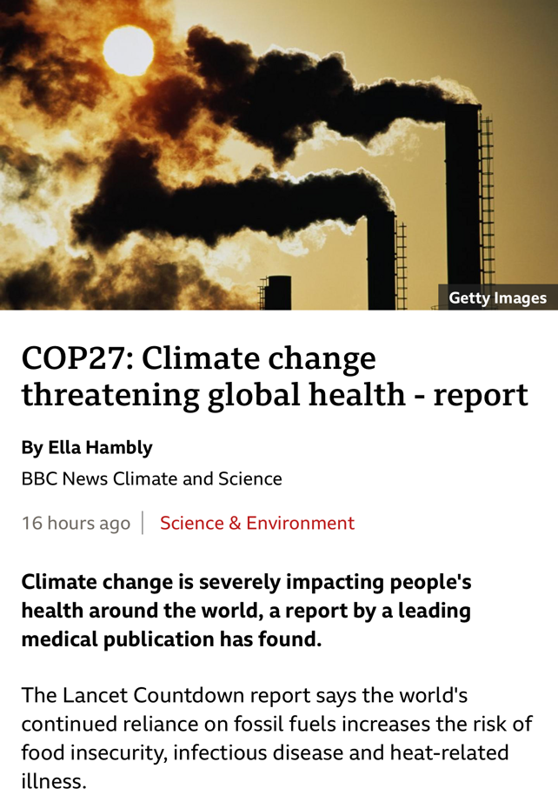
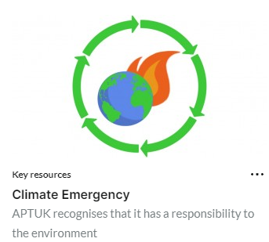
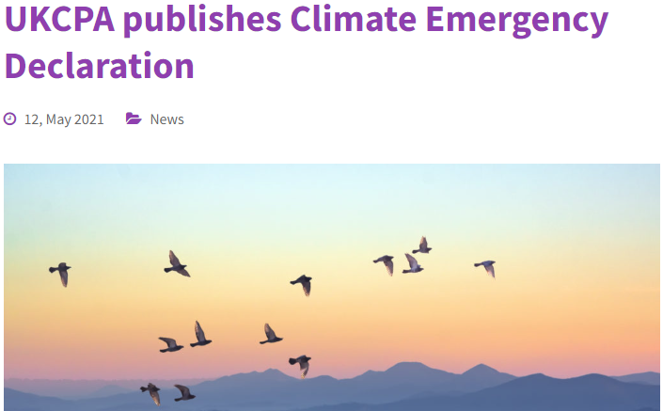
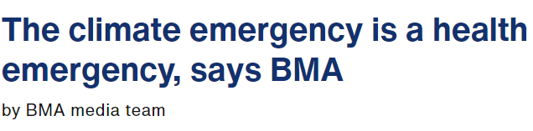
introduction
Notes:
reaching breaking point on Earth
professional bodies have started to recognise this too- the RPS has divested from fossil fuels,
APTUK (association of pharmacy technicians) and UKCPA have declared a climate emergency,
healthcare professionals in XR taking non violent direct action to stand up for the health and wellbeing of their patients, recognising that unless we do something quite drastic to change the way we currently live- existing health inequalities and overall quality of life on this planet is only going to get worse
(It might also be worth noting that every doctor/heathcare professional that has been arrested so far as a result of protesting has been acquitted- with the judges declaring their actions proportionate and in the best interests of their patients)
Pharmacy declares is another fantastic group of climate conscious pharmacy professionals based across the UK who are calling for divestment of fossil fuels, declarations of climate emergency, and climate health leadership & education

Slide 4
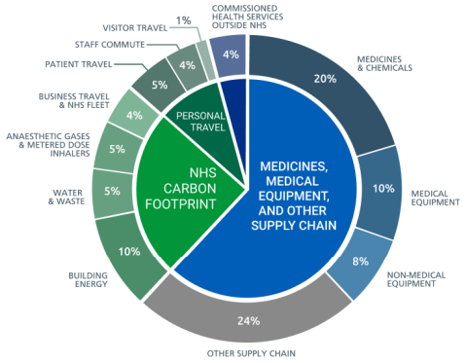
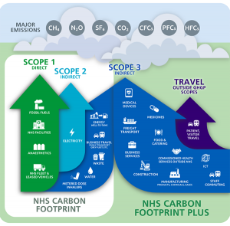
introduction
Climate emergency is a health emergency
In October 2020, the NHS committed to reaching carbon net zero
Direct emissions by 2040 (aim 80% reduction by 2032)
External emissions by 2045
‘Greener NHS’ – Delivering a Net Zero National Health Service
NHS accounts for ~4%- 5% of UK carbon emissions
~25% of which is attributed to medicines
Notes:
climate emergency is a health emergency, but what is difficult to reconcile here is that Healthcare itself can lead to environmental harm
recognise that along with other industries, we need to make healthcare as sustainable as possible to mitigate the impact on our climate
The NHS has committed to tackling climate change- it is the first national health service to commit to net zero
The Greener NHS initiative means gated target points addressing different aspects of our health service
the more wealthy the nation- the higher the carbon footprint of their healthcare system. Where it accounts for 4% of UK emissions, healthcare accounts for 10% of the carbon footprint of USA for example
Healthcare must be redesigned to safeguard our future
¼ footprint of NHS is medicines- Role of pharmacy professionals here is so clear and important

Slide 5
“The health of people around the world is at the mercy of a persistent fossil fuel addiction”
Lancet Countdown, 2022
Notes:
Lancet countdown- Annual publication monitoring the health impacts of climate change

Slide 6
Environmental impacts of medicines

Slide 7
What do we mean by carbon footprint?
‘Carbon emissions’ are the sum of all greenhouse gas emissions caused by an individual, event, organization, place or product
Expressed as carbon dioxide equivalent (CO₂e)
Examples of greenhouse gases include: Carbon Dioxide, Methane, Nitrous Oxide, Hydroflurocarbons
Notes:
Everyone is now talking abut the ‘carbon footprint’ of various areas- so what does it mean
In a nutshell- a number of GHGs exist with different properties, and ‘carbon emissions’ encompass all these emissions caused by individual, even organisation place or products
Carbon dioxide- largest contributor to global warming- 86% of UK’s climate impact- focus of climate change initiatives
Methane- mainly emitted by agriculture & landfill sites- 25x more potent (in terms of global warming potential) than co2 & accounts for ~7% uk climate impact
Nitrous oxide- mainly emitted in healthcare setting (hospitals), industrial processes and agriculture- 300 x more potent than carbon dioxite and responsible for ~6% uk climate impact
Fluorocarbons- responsible for much less (present in inhalers)
To make life easier, we express the overall Global Warming Potential of the gas cocktail emitted in CO2E, i.e. a metric which compares the GWP of this mixture, to equivalent amounts of CO2.

Slide 8
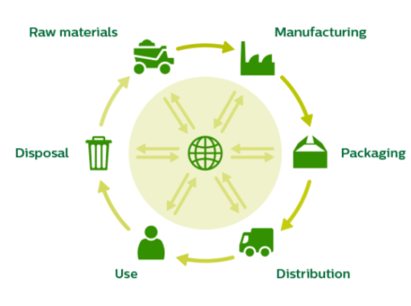
Calculating carbon footprint
Life Cycle Analysis of a product/service
Notes:
Ideal situation
Not always possible at the moment.
There is no agreed national/international methodology for undertaking CF.
(Greener NHS project)
Carbon footprinting (accounting tool) aims to identify carbon ‘hotspots’ in a process

Slide 9
Life cycle analysis of a pharmaceutical product
RAW MATERIALS & MANUFACTURE
Synthesis/extraction of chemical entities, energy used to manufacture and formulate medicines
PACKAGING
Plastic/hard plastic with foil/glass? Outer packaging?
DISTRIBUTION
Where was it made? What is needed to transport to end location?
Weight of load; Lorries/Ships/Air freight. Warehousing.
Sundries? Giving sets? PPE required?
ADMINISTRATION
Patient information leaflets
DISPOSAL
Appropriate destruction, wastewater contamination, incineration, contaminated sharps
Notes:
Not just point of use- an awful lot of resources & greenhouse gas emissions before the drug even leaves the manufacturing plant
For a true reflection of the environmental impact of a drug- one aspect of this being the ‘carbon footprint’ of a drug, need to consider all of the different processes that have brought the drug to you
Really hard to quantify- we only have this information in terms of carbon cost for a very small number of drugs

Slide 10
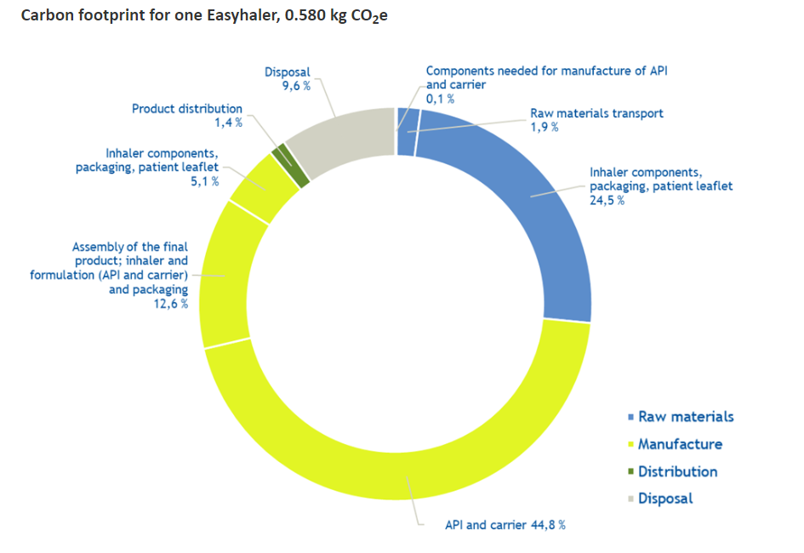
Example: dry powder inhaler
Notes:
Manufacture & accessing raw materials is the bulk of the carbon footprint
NB waste is actually a small part of a drug’s impact- bear this in mind when I discuss recycling

Slide 11
How to calculate carbon footprint

Slide 12
Calculating carbon footprint
No ‘validated’ way… yet
2 methods commonly used:
“Top down” vs “Bottom up” approach
Notes:
Well, the real answer is there is no agreed/validated way to do this at the moment- it is not a precise science yet

Slide 13
Top down
Economic model- financial spend is converted into CO₂e
Quick & dirty approach- gives a good overview, but lacks clarity & only once factor taken into account
0.155 x £ cost of drug = CO₂e
Notes:
Easiest way (most common)- uses a carbon emissions factor (per industry) based on £ spend- first described by sustainable development unit (was Greener NHS)
top-down
Purely financial- ‘follow the money’ financial spend in a sector is directly converted into a carbon dioxide equivalent / CF
Financial spend known from management accounts within an organisation/sector, so all items purchased by the sector can be included in the calculation.
Follow the flow of cash as they leave (output) one sector and input (arrive) in another sector.
That makes the top-down analysis all-encompassing and quick.
Downside very inprecise- factor is used for all pharmaceuticals equally, where the financial cost of items may vary.
Plus, only one carbon emissions factor per sector. E.g. same carbon footprint per £ spend, regardless of drug.
Therefore the cirect conversion of financial spend into a carbon footprint with the help of sector specific carbon emissions factors is therefore crude and the results can only ever provide a rough estimate of the footprint.
Quick and easy - can potentially identify ‘carbon hotspots in care pathways where we’re spending a lot of resources

Slide 14
Bottom Up
Engineering model- looks at each individual component part to produce an item/run a service
Identifies all the physical items/materials/resources required
V.specific- but time consuming!
If processes are missed- carbon footprint inaccurate & may underestimate impact
Notes:
Engineering method- each individual component- what is it made from, venflon- plastics, metals etc etc
Includes all forms of energy (liquid road fuels, electricity, gas etc.) and consumable items (plastics, paper, pharmaceuticals etc.).
Time consuming, not always get information you want
Not every company willing to share/currently recording everything going in to each process e.g. specific type of plastics used
CRADLE to GATE model – only looks CF of making base materials e.g. the plastic used to make a venflon.
Big systems- impossible to do all the time

Slide 15
Emissions factor database
BEIS database- UK Gov Greenhouse gas conversion factors for company reporting
Useful for ballparking energy use & transport, water supply, waste disposal
Notes:
BEIS database – UK government resource produced by Dept for Business, Energy & Industrial Strategy (BEIS))
The greenhouse gas conversion factors in the database are suitable for use by UK-based organisations regardless of size and gets updated every year.
Particularly comprehensive around energy use (different fuels and electricity) and transport.
Also includes emissions factors for water supply/treatment and waste disposal.

Slide 16
Emissions factor database
ICE database – ‘embodied carbon’
Carbon involved in raw material extraction, manufacturing & transportation at the factory producing the drug
NB excludes distribution to manufacturing plant, energy involved in manufacturing into final product, transportation to end user/distribution centre, use & disposal
Notes:
Paper medicines cups!

Slide 17
Notes:
Here are the current carbon factors to support calculations around carbon footprint of various care pathways
Eg. Penthrox (methyflurane) vrs sevoflurane

Slide 18
Non-carbon impacts of medicines
Notes:
‘more to this than carbon’!

Slide 19
Pharmaceutical pollution is contaminating water on every continent on the planet
Inappropriate disposal of rubbish- dumping along riverbanks
Metabolism of drugs –unmetabolised fraction reaches sewage
Poor Waste water infrastructure/ run off from manufacture & landfill
Knock on effects seen in animals (e.g. feminisation of fish)
Antimicrobial resistance resulting from low levels of abx in water systems
https://www.globalpharms.org/
Notes:
Not on Greener NHS agenda – although have been calls for it.
Other countries look at this e.g. Sweden & Norway
Some Trusts have started to include on formularies submissions (Dorset & NHS Highland)
EMA (environmental medicines agency) Environmental Impact Reports for drugs
Not standardised
? To do with the info

Slide 20
Recycling medicines
Notes:
So we now know waste is actually a tiny proportion of a ‘carbon footprint’ but nonetheless has a significant impact on the surrounding environment
So reducing the volume consumed is probably the most effective way of reducing pharma’s environmental impact, but where we must use, can we look to recycle any parts of medicines?

Slide 21
TerraCycle
Who are they?
Global waste management company
Global leader in ‘hard to recycle’ materials
Range of free recycling programmes on offer
‘Zero Waste Box’ available to purchase by pharmacists
Notes:
Shampoo bottles/coffee pods etc
Zero waste box for blister packs

Slide 22
Pros & Cons
Pro
Will accept any brand of empty medicine blister packs
Available to pharmacists and healthcare professionals in medical settings
Order online & send back using pre-paid envelope
Carbon neutral shipments
Con
Not suitable for use at home- pharmacy only
Cannot accept cardboard or paper; blister packs only- must separate waste before sending in
Available mainland Britain only
Cost of box £91.50 (small) up to £198.72 (large)

Slide 23
Teva Inhaler Recycling
What is it?
Inhaler recycling service provided by Teva
In association with Terracycle
Plastic and aluminimum recycling & gas capture
Pilot scheme
Only small number of pharmacies involved currently & community only pilot
No ongoing service for UK pharmacies to enrol
Notes:
Pilot scheme; does not appear to be available to more pharmacies to sign up in the UK– some information for Ireland.
No silver bullet yet

Slide 24
Case study: Leicester NHS Trust
Take AIR (action for inhaler recycling)
Collaboration between Chiesi & University Hospitals of Leicester NHS Trust
Postage based recycling scheme; pre-paid envelopes to recycle up to 4 inhalers
Year long pilot extended a further 6 months- now finished (Aug 2022)
Over 20,000 inhalers recycled & >64% of pharmacies in the area took part
HOWEVER; no further plans to extend nationally- limited long-term funding
Notes:
But-no longer funded??

Slide 25
Pencycle
What is it?
Novo Nordisk initiative to recycle pre-filled insulin pens
From Sept 2022 available to all community pharmacies in the UK following successful pilot
Free for pharmacies to sign up
www.pen-cycle.co.uk
Not available in hospitals
Notes:
Success story!

Slide 26
What’s next?

Slide 27
Greener NHS initiatives
Notes:
Going back to the Greener NHS initiatives here- they are predominantly focussing on this 4th area around low carbon technologies .e.g with anaesthetics- reducing desflurane use and looking at gas capture technologies and we’ve also seen this with respiratory inhalers, and in to a certain extent 3 (through elimination of nitrous oxide waste).
However, there is a wealth of gain to be achieved by focussing on 1, 2 & 3. This is down to us.
Professor Tony Avery – New National Clinical Director of Prescribing
Deprescribing tools etc

Slide 28
What could this look like?
Carbon as currency
Medicines reconciliation
Education & patient information
IV to oral switches
Minimise waste
Notes:
We’re so used to finding cost effective treatments and technologies- and often where there are cost savings to be had, there are carbon savings to be had- start to consider and prioritise the environmental as well as the up front financial cost
Formulary requests to include carbon footprint of medicines?
NICE TAs
Medicines reconciliation & meds optimisation-
As pharmacists we must ensure optimal use of medicines for the sake of our patients & the planet
This includes de-prescribing, Ensuring medicines are used effectively
Reducing the number of medicines patients are taking and ensuring the medicines they are taking are used appropriately
IVPO switch- (Cardiff Study, switching IV PO paracetamol, 1/3 over, saves 5 tonnes CO2e per year)
Fewer consumables
Less plastic
Discharged home sooner
Education- empowering staff members to talk to patients about climate
Ensuring patients know that by taking medicines effectively, that is an excellent want to support a more sustainable healthcare system
Carbon literacy training
Signposting online info where appropriate
Counselling and waste reduction including reducing stockpiling at home
Minimising waste- re
WE CAN DO SO MUCH ALREADY AS PHARMACISTS- call to action

Slide 29
Resources available
SPS
RPS sustainability policies
Pharmacy declares pharmacydeclares.co.uk/
prescqipp.info (inhalers)
seesustainability.co.uk (primary care) – FREE carbon footprinting training
carbonliteracy.com
Centre Sustainable Healthcare (sustainablehealthcare.org.uk)
Pharma companies- ask for their environmental impact reports!

Slide 30
thank you
Caroline Dalton
caroline.dalton1@nhs.net

