Slide 1
Documentation of Fridge Temperature Excursion Enquiries in Medicines Information
Rebekah Hewitt (rebekah.hewitt@nhs.net) and Mehreen Karim, Oxford University Hospitals NHS Foundation Trust
Why did we carry out this audit?
Expected role of pharmacy according to RPS and CQC
Requested by our lead medicines governance pharmacist
FTE: Fridge Temperature Excursion
➜ When a fridge containing medicines in a clinical ward setting was outside of the expected range (2-8°C)
Reported to MI to investigate stability of products
Wastage of drugs
Guidelines on management
Financial cost

Slide 2
Documentation of Fridge Temperature Excursion Enquiries in Medicines Information
Rebekah Hewitt (rebekah.hewitt@nhs.net) and Mehreen Karim
Aims and Objectives
To determine whether FTEs reported to MI were processed correctly according to the internal MI Temperature Excursion Policy and Cold Chain Breach Procedure for Clinical Areas (CCBPCA)
To calculate the financial costs of FTEs within the trust that are reported to MI.
What were we expecting?
Criterion | Audit Standard (%)
Input documentation received by MI from enquirer (including Cold Chain Breach Form (CBBF), Temperature Log and Action Taken Form) | 100
Appropriate resources used for research undertaken by MI team (including SPS, SPC, manufacturers, past enquiries and/or clinical judgement) | 100
Answer given by MI to enquirer to include stability, licensing, expiry, storage and label if product suitable for use | 100

Slide 3
Method: how did we do it?
Documentation of Fridge Temperature Excursion Enquiries in Medicines Information
Rebekah Hewitt (rebekah.hewitt@nhs.net) and Mehreen Karim
Inclusion Criteria | Exclusion Criteria
FTEs reported to MI occurring in a clinical setting within OUHFT | FTEs occurring in a domestic setting
Enquiries marked as ‘completed’ on MI DataBank between May 2020 – October 2020 | Temperature excursions involving a medicinal product left out of or put into a fridge inappropriately
Products involved in a previous temperature excursion | Room temperature excursions
 | Products involved in FTEs that were not able to be found on the Bedford pharmacy system
 | Products involved in excursions that were not supplied by pharmacy e.g. blood bank products
MI DataBank for data collection
Bedford (pharmacy computer system) used for pricing details
Excel to collate data
Limitations:
- insufficient detail on reporting of excursion
- items unable to be identified on Bedford

Slide 4
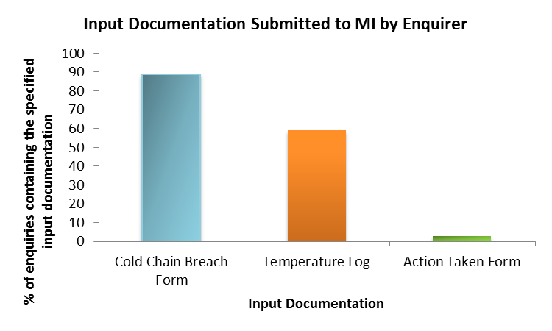
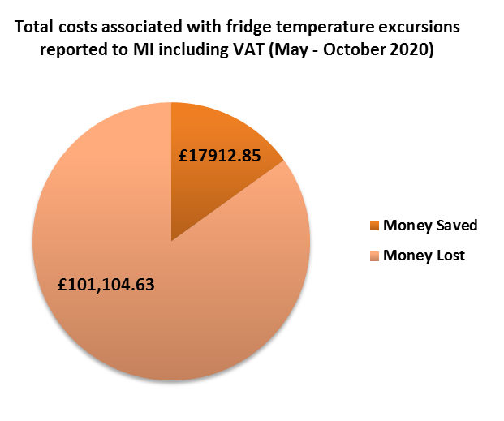
Results
Documentation of Fridge Temperature Excursion Enquiries in Medicines Information
Rebekah Hewitt (rebekah.hewitt@nhs.net) and Mehreen Karim
Criterion | Audit Standard (%) | Result (%)
Input documentation received by MI from enquirer (including Cold Chain Breach Form (CBBF), Temperature Log and Action Taken Form) | 100 | 0
Appropriate resources used for research undertaken by MI team (including SPS, SPC, manufacturers, past enquiries and/or clinical judgement) | 100 | 89
Answer given by MI to enquirer to include stability, licensing, expiry, storage and label if product suitable for use | 100 | 100

Slide 5
Documentation of Fridge Temperature Excursion Enquiries in Medicines Information
Rebekah Hewitt (rebekah.hewitt@nhs.net) and Mehreen Karim
Conclusion
Input documentation: (lacking) detail of standards reflected in results.
Research: Satisfactory performance and good practice of MI team.
Answers: Able to provided without Action taken log
Cost: value in MI involvement in pharmacy storage.
Recommendations All of which have been carried out. A re-audit is due to be carried out for the same time-period in 2021.
1. MI be made aware of audit findings to increase awareness and promote good practice | 2. Changes made to CCBPCA to include alteration of the CCBF to prompt enquirer to provide all necessary detail on initial contact with MI | 3. Template for responding to FTEs created on MI DataBank | 4. Financial cost of FTEs on a quarterly basis at governance meetings to identify patterns regarding problematic ward locations and/or fridges

