Slide 1
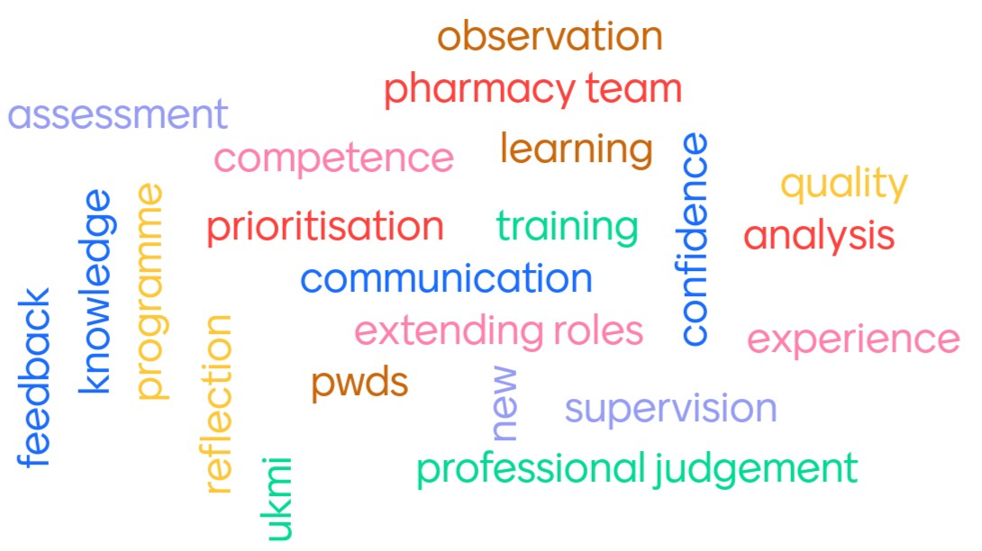
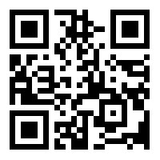
Medicines Information and Advice Training Programme
The Future of Specialist Medicines Information Pharmacy Technician Training
Background
Pharmacy Workforce Development South (PWDS) are a leading NHS Pharmacy Education & Training Provider and have been responsible for the delivery of the Accredited Medicines Information Technician Training Scheme (AMITTS) since December 2022.
AMITTS was developed in 1999 to provide UKMI accreditation to pharmacy technicians (PTs) wishing to specialise in MI. Since its development, many educational reforms and changes to practice have occurred, including professional registration of PTs¹⁻³.
Specialist MI PTs are contributing to increasingly varied and complex functions in MI units.
Service Development Aim
Pharmacy Workforce Development South (PWDS) aimed to review, develop and redesign AMITTS to create the new Medicines Information and Advice Training Programme.
To work in collaboration with UKMI, in line with national and educational practice standards.
To support MI pharmacy technicians for their current and future roles.
To reflect the current and future workforce needs through new enquiry-type categories and novel competencies.
The new programme will be a robust, accessible, relevant, quality assured programme, endorsed by UKMI and delivered by PWDS.
Method
A programme board was created that provided expertise in MI, training and service provision. The board represented pharmacists and pharmacy technicians, UKMI and non-UKMI pharmacy team members, SPS staff and different home nations.
The board reviewed the portfolio-based programme requirements and agreed changes to encompass the broader enquiry workload experienced by current MI PTs. These changes included: new enquiry categories and novel assessment pathways to align with current educational practice and UKMI standards.
Existing enquiry types were reviewed to ensure relevance and reflection of the full range of enquiries included in the category.
Online delivery of training was redesigned to provide deeper underpinning knowledge in all enquiry categories.
The quality and suitability of the new programme is assured through endorsement of programme decisions by the UKMI executive.
Enquiry Categories
Access to medicines on the NHS
Adverse drug reactions
Availability of medicines
Complementary medicines
Formulation of medicines
Identification
Interactions
IV compatibility
Member of public enquiries
Palliative care syringe drivers
Renal impairment
Stability of medicines
Transfer of care
Vaccinations
IV administration
Discussion
Major changes to the AMITTS programme were needed to reflect the extended roles undertaken by professionally registered specialist MI pharmacy technicians.
Enquiry categories will be significantly expanded to 15 enquiry types.
Existing MI PTs can extend their roles by undertaking supplementary training and assessment in any of the enquiry categories offered by the new programme.
The new programme is expected to launch in February 2024.
This new programme allows UKMI to fully utilise the skills and potential of their specialist PT workforce. It supports workforce recruitment and retention through facilitating career progression opportunities.
Regular programme review will ensure it remains aligned to educational reforms and the needs of UKMI.
Further development and expansion of the programme to primary care pharmacy professionals and non-UKMI workforce are future aims.
Opportunities for Pharmacy Technicians New to Medicines Information
Opportunities for Existing
Medicines Information Pharmacy Technicians
The new UKMI endorsed Medicines Information and Advice Training Programme for pharmacy technicians will be available early 2024
Learners will be able to select from 15 different enquiry types to develop and demonstrate competency in
Assessment will include direct observations, portfolio of evidence, holistic review, reflective writing, and summative interview
As the role of specialist MI pharmacy technicians has expanded, so has the training programme
The new UKMI endorsed Medicines Information and Advice Training Programme supports MI pharmacy technicians to extend their roles
MI pharmacy technicians will be able to select any available enquiry category to extend their existing accreditation
Assessment will include an e-portfolio of evidence, direct observation and holistic review
Underpinning knowledge will be provided through practice development days
Authors: Michele Skipp and Kate Postle, Pharmacy Workforce Development South, www.pwds.nhs.uk
References
Health Education England. Advancing pharmacy education and training: a review. https://www.hee.nhs.uk/sites/default/files/documents/Advancing%20Pharmacy%20Education%20and%20Training%20Review.pdf (accessed 13/09/23)
General Pharmaceutical Council. Standards for pharmacy professionals. May 2017. https://www.pharmacyregulation.org/sites/default/files/standards_for_pharmacy_professionals_may_2017_0.pdf (accessed 13/09/2)
General Pharmaceutical Council. Standards for the initial education and training of pharmacy technicians. October 2017. https://www.pharmacyregulation.org/sites/default/files/standards_for_the_initial_education_and_training_of_pharmacy_technicians_october_2017.pdf

