Slide 1
A study to assess the impact of a complete IT failure on the delivery of a Medicines Information service at a large teaching hospital
Jesal Lakhani and Vishnu Kumar
Notes:
Hello, My name is Vishnu, Medicines Information pharmacist at Guy’s and St Thomas’ Hospital London. This project was undertaken by Jesal and I. The title is “ A study to assess the impact of a complete I.T failure on the delivery of a medicines information service at large teaching hospital. MOVE TO NEXT SLIDE

Slide 2
IT Outage – Background and events
The IT outage experienced by GSTT in July 2022 was a highly unanticipated rare event
Following this experience, it posed various questions for future events:
Are there contingency plans in place for a complete IT failure – i.e. no access to a computer or applications such as MIDB, Word, etc.
Are there contingency plans in place for network issues – i.e. resulting in loss of access to printers, G-drive, shared files
Similar to the COVID pandemic, there was no specific guidance/protocols available to cover this scenario and this experience has taught us the importance of having a plan in place for any future events
What improvisations we made to continue the MI service during the IT outage
First two days when there was no computer access – enquiries were redirected to LNWH MI unless GSTT specific – then told to contact us back
As MIDB was not accessible – staff were recording research and enquiries on multiple platforms – paper, Emails, Teams, Word (if accessible) and sending to seniors to check before sending out
Once Teams was working – interim tracker was created to keep a log of enquiries and deadlines and who to allocate to
Notes:
Voice over-
Heatwave caused an IT outage in July 2022
The MI service continued to deliver with limited IT access during this period [19th-28th July 2022]. It was not known how long the outage would last, so planning had to take into account this uncertainty.
The first few days when we had no access to computers, we redirected enquiries via phone to LNWH
Once we had limited access, we were recording research to enquiries on various platforms such as Word, Email, Teams
When Teams was working – created the interim Tracker NEXT SLIDE
Background of service- streams of work, staffing, sps transformation- emphasises on the reliance of computers and MIDB and other various apps
~1 min

Slide 3
Aims
Methods
This research aims to identify areas of improvement to streamline the process in event of total IT outages in the future
To produce operational procedures which can be implemented across other MI centres.
To ascertain staffing experience throughout the IT outage
Retrospective quantitative data from MIDataBank and interim enquiry tracker
Quantitative and qualitative data using a questionnaire
Notes:
AIMS
- To investigate the impact of IT failure on the service provision of Medicines Information (MI)- To evaluate the importance of fully functioning I.T systems and application is in order to provide the MI service.
- To establish a protocol for future I.T incidences which can replicated at other trust/ MI centres
- To ascertain staffing experience throughout the IT outage
METHOD
- Quantitative data was ascertained retrospectively from MIDataBank and an interim enquiry tracker developed during the outage whilst MIDB was unavailable.
- A questionnaire was developed to collect data from MI staff consisting of a combination of open and closed questions about their personal experiences of how work was affected by the IT outage. From this we were able to identify common themes and some quantative data on what has occurred during the IT outage. NEXT SLIDE

Slide 4
Results
Themes
uncertainty about resolution date and a lack of procedures in place
MiDB Search function | Number of enquires
Total number key worded ‘IT incident’ | 177
IT incident interface enquiries | 48
Backlog of enquires logged on MiBD with no access | 27
Missed deadline of those enquires on MiBD | 18
no standardisation
time consuming processes/backlog of documentation
inconsistent triaging
disrupted workflow
variation in method of documentation of enquiries
Interim tracker figures | Number of enquires
Total number of enquires logged | 66
Number of enquirer completed | 48
Number of enquiries completed within deadline | 37
difficulty in checking enquiries
poor documentation
Notes:
Common areas of concern included: inconsistent triaging, poor documentation, variation in method of documentation of enquiries, difficulty in checking enquiries, time consuming processes/backlog of documentation, disrupted workflow, no standardisation, uncertainty about resolution date and a lack of procedures in place.
This was very important information for us as it allowed us to identify area of improvement which we can focus on when it comes to constituting and implementing a standard procedures in event of IT failures.
During the 7 working days of the IT incident occurring, we logged 177 enquiries related to the IT incident (of which 48 were interface enquiries regarding discharged etc, so overall we received 129 enquiries) – which were documented. Before the interim tracker went live – many people were taking in and completing enquiries, which may not have been logged, therefore the number in reality is >129.
Deadlines for 18 enquiries logged on MIDB were missed due to not being able to access MIDB, once the interim tracker was running and we had read only access to MIDB, we were able to catch up with the rest of the deadlines. This shows how effective the interim tracker was in terms of organising workflow when IT systems were down. And off course missing deadlines can have serious implication on patient safety so it is imperative to have procedure that can be implemented immediately so missed deadlines can be limited. NEXT SLIDE
Two of the key themes were that there was a lack of procedures in place and there was no standardisation, and this is reflected by the fact that multiple methods were being used for documentation. This meant that information was kept is multiple places and when it come to checking enquires it become difficult.
Another key theme was disrupted workflow, this was a result of firstly not having the access to internet/intranet and the applications which we would normally use but problems were made worse by the fact that we had no access to shared drives- within shared drive is where all our paper copies are kept for logging enquiries etc, however as the printers are connected to the Network, they were also down and we would have been unable to print anything had we had access to the shared drive.
Of the 66 enquiries logged on the interim tracker, 48 were completed and the rest had longer deadlines therefore were transferred over to MIDB once it was live.

Slide 5
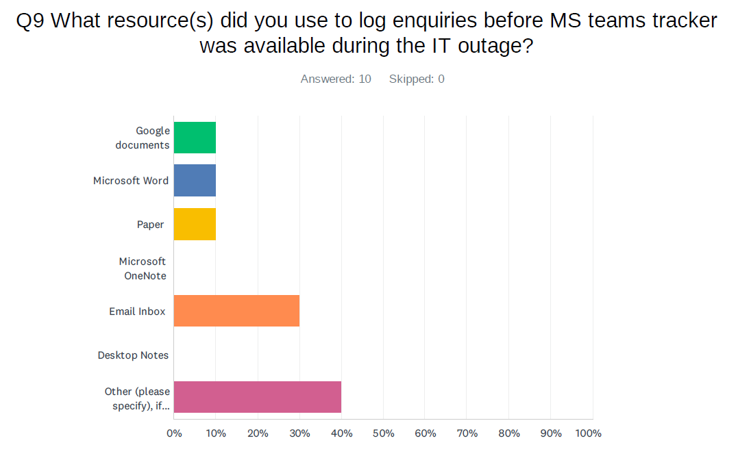
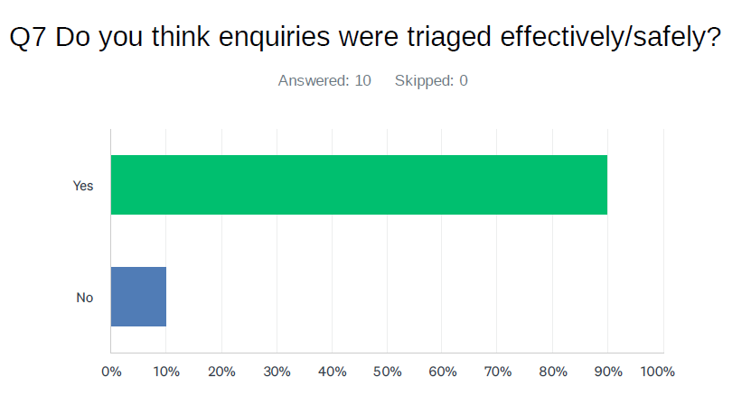
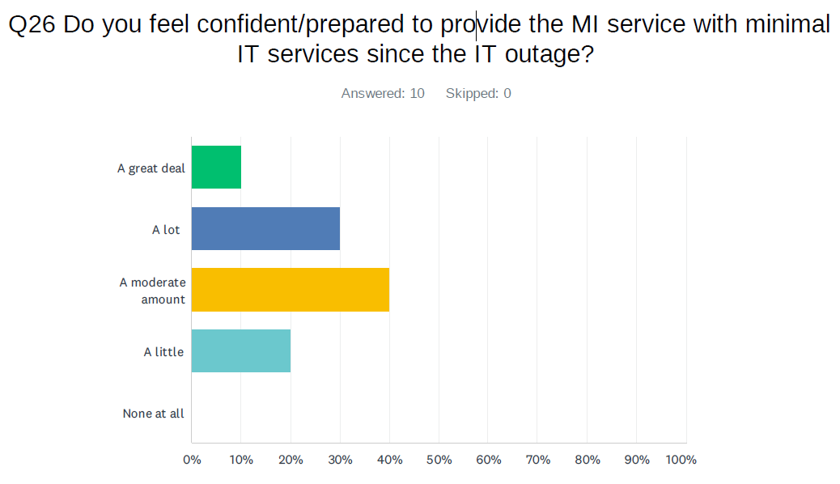
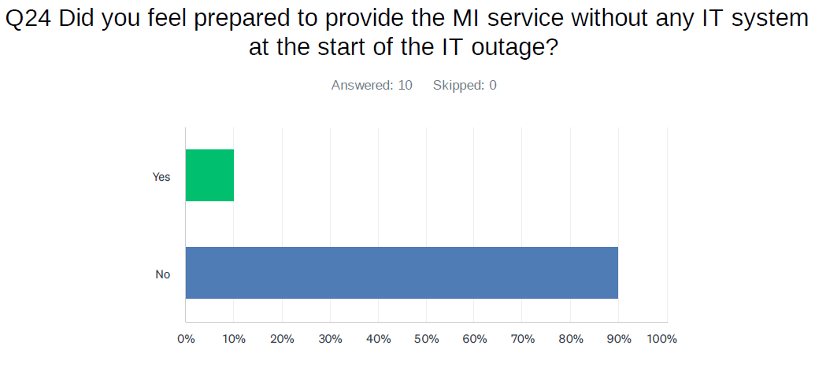
Results
Resources used to log research included:
10% Google Document
20% Word
20% OneNote
20% Email
30% Other (eg Teams, WordPad)
How checkers found the checking process
Longer to check
Process was not uniform due to multiple platforms being used
Less rotationals in MI at the time therefore less staff required checking
Difficult to know when enquiry ready to check
Notes:
Voice over a few results
1st Graph- As you can see from the first graph a wide range of resources were used to log enquiries during the IT downtime, this meant that the process followed by the team were inconsistent as there was no set procedure. Other included - paper, email inbox, OneNote (multiple resources)
2nd graph- In respects to patient safety, 90% of staff thought that enquiries were triaged safety and effectively meaning that all enquiries that come in despite not having access to full IT application, the interaction the agent had with enquirer evolved gathering all the relevant information in order for the question to be answered safely
Before the outage, 90% of staff did not feel prepared to provide an MI service without and IT and once we had this experience, and created the interim tracker etc there was a clear improvement in how prepared the staff felt for any future similar scenarios
Read results form the pink blob and expand on the points

Slide 6
Conclusion and implementation
A fully functioning IT system is crucial for the provision of the MI service and are heavily dependant on it.
The UKMI risk management procedure does not have a process in place for the management of a complete IT failure.
There was no local GSTT procedure for managing MI without IT systems and the findings from the survey indicate that MI was totally reliant on functioning IT systems.
Feedback from the experience has shown that the MI service can be continued with limited IT access for short periods of time.
Implementation:
1- A need for paper-based ‘IT downtime’ procedures
2- interim tracker for enquiries ( which was successfully implemented during the IT outage)
3- Sufficient quantity of ready-printed enquiry forms, especially if printers and photocopiers are network based.
Notes:
Voice over
There is a need for paper-based ‘IT downtime’ procedures (for both short term and longer term IT outages), interim tracker for enquiries and sufficient quantity of ready-printed enquiry forms, especially if printers and photocopiers are network based.
This will facilitate the transition from electronic to paper-based working ensure a uniform process used amongst staff. These recommendations can be implemented at all MI sites in event of a complete IT failure. Whilst we recognise that this was a unique event, the risk of a cyber-attack that could have a similar impact is likely increasing
We recommend a folder with printed copies of all paperwork that would be required (and sufficient number of copies) be stored in the MI office for possible future events

