Slide 1
Mental health enquiries
How does an MI pharmacist in a MH trust approach these?
Morven Henry
Specialist MI pharmacist – mental health
NHS Greater Glasgow & Clyde MI Service

Slide 2
What's the difference?

Slide 3
What's the difference?
Less clear prescribing guidelines
Some information not written down – clinical experience based
Less evidence for prescribing decisions
Patients with complex needs
Very individualised approach
Response
Side effects
Co-morbidities
Often no clear answer – provide balance of information

Slide 4
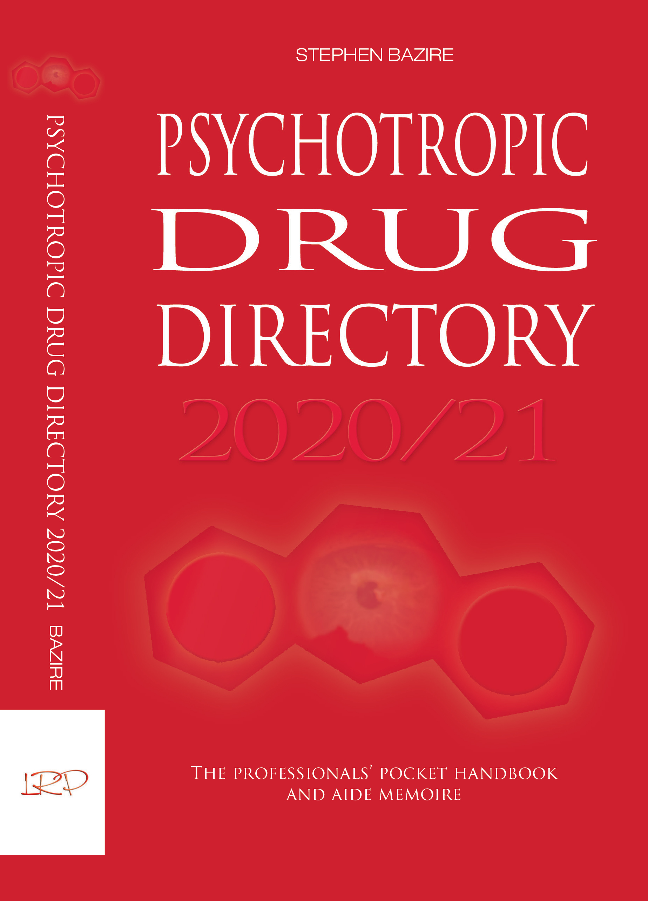
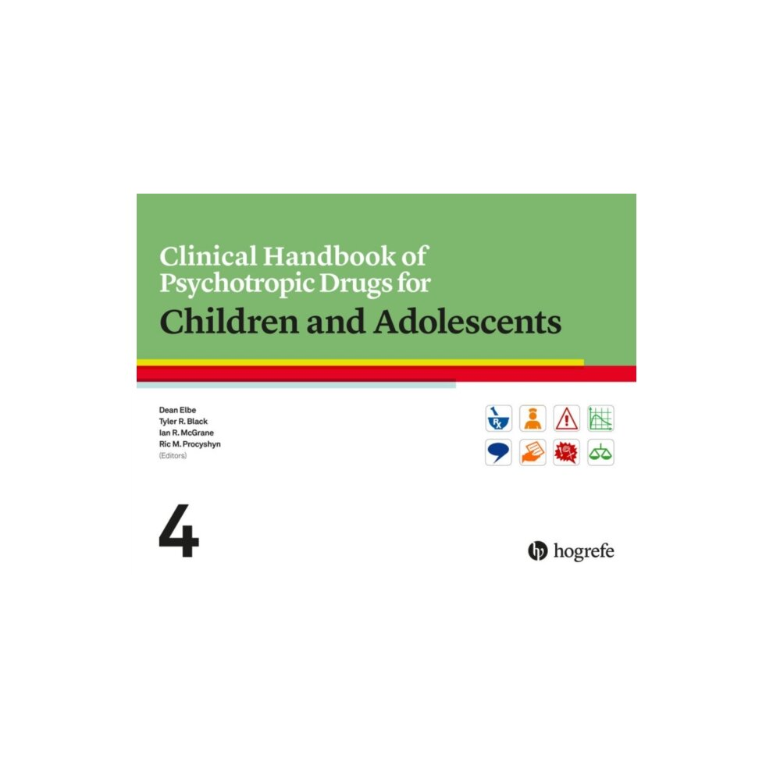
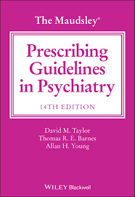
UKMI recommended resources for psychiatry
CORE
Psychotropic Drug
Directory
The Maudsley
Prescribing Guidelines
in Psychiatry
ADVISORY
Clinical Handbook of Psychotropic Drugs for Children and Adolescents

Slide 5
Psychotropic Drug Directory
Pros
Cons
Now available as an ebook (as well as print)
Contains a huge amount of information
Referenced throughout
Full chapter on management of side effects
Chapter on 'psychotropics in problem areas' very comprehensive (e.g., bariatric surgery, glaucoma, sleep apnea)
Includes some clinical commentary
Use the contents page to find the information you're looking for
Some information can be based on low quality evidence
Can be difficult to read
Can be difficult to find relevant information (some very useful tables are hidden amongst the text)
Searching the index is less useful for finding relevant information

Slide 6
Maudsley Prescribing Guidelines
Pros
Cons
Available as ebook and paper edition
Comprehensive
Easy to read, good background info – puts things in context
combination of literature review and expert contribution from psychiatrists and specialist pharmacists so the advice often goes beyond the licensed indication of many drugs
Fully referenced (at the end of each section)
Intended for worldwide audience so includes info on some drugs not used in UK
Not designed as an online resource so best to become familiar with the contents rather than using 'search' function

Slide 7
Clinical Handbook of Psychotropic Drugs in Children and Adolescents
Pros
Cons
Very specialist
Useful comparison charts and summary tables
Includes information based on clinical experience
Comprehensive info on ADHD medicines
North American – some drugs not used in the UK/some UK drugs not used in US
Unusual layout – can involve lots of reading to find relevant information

Slide 8
Useful resources – free to access
Local guidance – mental health trusts
National guidance – British Association of Psychopharmacology, NICE, SIGN
Royal College of Psychiatrists
SPS
Mental health colleagues
International guidance
Manufacturer medical information (e.g. Janssen, Otsuka, Lunbeck, Takeda)
The Ashton Manual (benzo.org.uk)

Slide 9
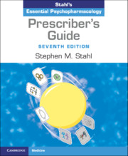
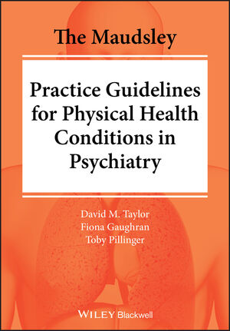
Useful resources – paid/subscription
Stahl's Essential Psychopharmacology: Prescriber's Guide
The Maudsley Practice Guidelines for Physical Health Conditions in Psychiatry
Choice and Medication (www.choiceandmedication.org)
College of Mental Health Pharmacy
Training courses
Membership (email discussion group)
CPPE online workshops

Slide 10
Worked example of a mental health enquiry
CAN MIRTAZAPINE BE GIVEN AS A 7.5MG DOSE?
Taken at face value:
There is a licensed 15mg/ml oral solution
Mirtazapine 15 mg film-coated tablets:
3. Pharmaceutical form
Tablet, film-coated.
Yellow, scored on both sides, 10 x 5.2 mm oval, biconvex, film-coated tablets.
The tablet can be divided into equal doses.

Slide 11
Worked example
Questions to think about:
Why?
Will mirtazapine be effective at a 7.5 mg dose?
Is sedation a dose-related effect?

Slide 12
Worked example
Questions to think about:
Why?
Will mirtazapine be effective at a 7.5 mg dose?
Is sedation a dose-related effect?
Pt just started on mirtazapine 15 mg but finds it too sedating
Depends on indication – for depression, no.
Yes, to some extent but it is an inverse relationship

Slide 13
Worked example
Answer
A lower dose of mirtazapine will not be less sedating.
Try 30 mg dose at night – although it seems paradoxical, it is likely to be less sedating (and more effective) due to a change in receptor binding profile.
Also advise patient that sedation may improve over time so try to give it a week or two.
If the patient is unable to tolerate sedation then an alternative may be required.

Slide 14
Sources used:
SPC (section 4.8)
Psychotropic Drug Directory (chapter 6 – management of side effects)
Choice and Medication website

