Slide 1
Centralisation of UHB Medicines Information Implementing efficient work processes to manage an increased workload
K Davies, A Punjani, AK Sunder

Slide 2
Background
April 2018 the new University Hospitals Birmingham (UHB) NHS Foundation Trust formed following the merger of Queen Elizabeth Hospital Birmingham (QEHB) and Heartlands, Good Hope and Solihull hospitals (HGS).
April 2020, Mi services were centralised at Solihull hospital, and in November 2020 the Helpline was extended to patients discharged from QEHB.
The new Trust has more than 2,700 beds across all sites.
Notes:
The new Trust is one of the largest in England, with more than 2,700 beds across all sites.

Slide 3
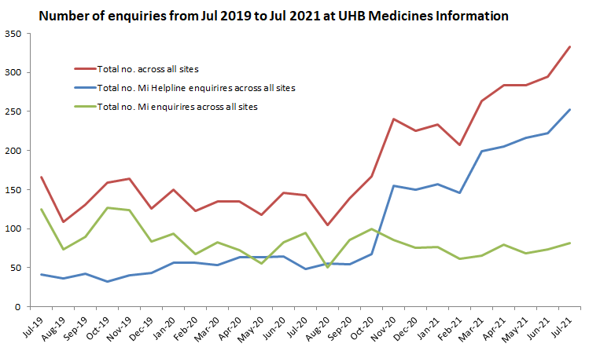

Slide 4
How we increased efficiency
Write clear effective handovers which also list remaining work in priority order
Received an increased resource of 0.4 WTE
Used a generic Mi e-mail account for all Mi work
If staffing is short, use the priorities-first rule ie. only complete the most clinically urgent enquiry before moving on
Subject field in e-mails should contain the enquiry number to allow follow-up by other other team members
New individual phones with headsets to aid working paper-free and input straight onto MiDatabank as per UKMi standards
Notes:
Using protected time to cover staff completing L3 enquirires

Slide 5
How we increased efficiency
Utilising the Interface Prescribing Manager (Senior Pharm Tech) to support the Medicines Helpline.
Publish of the Mi newsletter bi-monthly to aid communication of common enquiries and incidents occurring
Carrying out Mi-drop-in days at other sites to aid training and allows for staff to maintain good contact with Mi
Training has been redesigned to accommodate 11 Foundation Pharmacists.
Future team building events
Notes:
Helpline enquiries were reviewed and demonstrated that approximately 65% could be classified as ‘interface issues’ which could reasonably be directed to this role.
Training was reduced from 4 weeks to 3 weeks with 2 initial virtual workshops to cover the background information and general processes. The initial workshops enabled trainees to answer phones, and take in enquiries almost immediately. The rota was planned so that trainees overlapped in MI. This was extremely helpful as the trainee in their final training week supported their colleague during their first week reducing support needed by MI staff.

