Slide 1
Assessing Pharmacy Confidence in the Safety of Drugs in Lactation: Scope for Further Learning and Multi-Disciplinary Education
Jessica Jones
Mpharm MRPharmS

Slide 2
Assessing Pharmacy Confidence in the Safety of Drugs in Lactation:
Scope for Further Learning and Multi-Disciplinary Education
Jessica Jones Mpharm MRPharmS
Background
Results and Discussion
Results and Discussion
Conclusion
Pharmacists and pharmacy teams are responsible for protecting the public from the harmful effects of their medicines and are perfectly placed to provide support, information and education to new mothers on the safety of their medicines in breastfeeding.
The World Health Organisation (WHO) currently recommends exclusive breastfeeding for the first 6 months of life, followed by partial breastfeeding for up to 2 years and beyond^{i}.
Within the UK, 60.2% of newborns are breastfed within the first hour of life. This figure drops to 48.1% within the first 6-8 weeks, with less than 1% continuing to breastfeed until the age of 2 or beyond^{ii}.
This is predominantly due to lack of support and inconsistent messaging from healthcare professionals^{iv} and can result in higher rates of postnatal depression, maternal guilt and trauma^{v}.
There is scope for all healthcare professionals to improve maternal access to breastfeeding support and information.
.
Sources of Information
The BNF was found to be the modal source of information.
Only 5.2% (n=12) had used Hale’s Medications and Mother’s Milk, 6.6% (n=15) had previously accessed LactMed and 1.5% (n=3) had used the UKDILAS service.
Public Health
Around 22% of respondents were unaware of the health benefits breastfeeding can provide to new mothers, and 25% were unaware of the health benefits for breastfeeding newborns.
53% did not correctly identify the conditions that would pose a contraindication to breastfeeding, such as phenylketonuria and galactosaemia.
Over half of all respondents simply stated that they ‘did not know’.
Training and Education
Over 90% of respondents had not received any further training outside of their MPharm degree or Buttercups training pertaining to the safety of drugs in lactation.
91% stated that they would like to see an online learning course available to all pharmacy teams, which would encompass video lectures, multi-disciplinary training and further CPD articles.
Confidence and Clinical Knowledge
Only 20% of respondents correctly identified the medications suitable for use in breastfeeding, and a further 15.2% stated they did not know which medicines were suitable, suggesting a disparity between the perceived confidence of pharmacists and their response to queries.
27.8% of pharmacists did not recognise that codeine was less suitable for use in breastfeeding, and 47.2% of pharmacists did not recognise that aspirin is also contraindicated in breastfeeding mothers due to the risk of Reye’s syndrome.
Pharmacists and technicians working within GP surgeries and hospitals performed better in this area, despite the majority of these respondents stating that they were only ‘somewhat confident’ in their clinical knowledge of drugs in lactation.
When asked about the advice they would give to breastfeeding mothers if they did not know whether the medication was safe in breastfeeding :
50% of all respondents stated that they would ‘ask the patient for time to look up the medication’.
23% of respondents stated that they would contact an MI service, or signpost the mother to a midwife, health visitor, GP or consultant.
4% stated that they would recommend taking the medication after a feed
2% advised ‘pumping and dumping’ breastmilk whilst taking the medicine.
4% said that they would advise the mother to avoid the medication
4% stated they would advise that the mother avoid breastfeeding altogether.
80% of respondents stated that they felt pharmacists and pharmacy teams were not currently well equipped or trained to answer queries relating to the safety of drugs in lactation.
The results indicate clear gaps in pharmacist knowledge regarding the safety of drugs in lactation, as well as a lack of wider understanding of breastfeeding as a major public health issue, and have therefore been used to aid discussions with expert organisations in their approach to the training of pharmacy teams and promotion of available research and resources.
It is hoped that the results of this survey will encourage pharmacists and pharmacy teams to review their own knowledge and current practice, and undertake further learning where necessary.
Aims
To understand the overall perception of breastfeeding as a public health concern amongst pharmacy teams
To explore the current gaps in knowledge relating to the safety of drugs in lactation.
To explore the methods by which further education may be delivered to pharmacy teams
Acknowledgements
With special thanks to:
Dr Wendy Jones (MBE PhD MPharmS)
The Breastfeeding Network Volunteer Drugs in Breastmilk Pharmacists:
Gayle Anderson (MPharm MRPharmS), Lottie Ayres (MPharm MRPharmS)
Abigail McDougall (MPharm MRPharmS), Sam Morris (Mpharm Hons)
Jenny Oliphant (MPharm MRPharmS), Reena Patel (Mpharm MRPharmS)
Nadine Revell (MPharm MRPharmS), Sarah Robinson (MPharm MRPharmS), Zoe Roseblade (MPharm MRPharmS) & Phillipa Winter (MPharm MRPharmS)
Christine McCartney, Lead Clinical Pharmacist, County Durham and Darlington NHS Foundation Trust
Rachel Smith, Deputy Chief Pharmacist, County Durham and Darlington NHS Foundation Trust
Methodology
Data was gathered via a survey using the Google Surveys application, over a 2 month period (March – May 2021) and targeted pharmacy teams across all sectors.
Questions were asked regarding the public health impact of breastfeeding, in addition to clinical questions concerning the safety of medicines in lactation. Education, provision of teaching opportunities and the availability of current resources were also addressed.
The survey was disseminated online via the UKCPA website and via clinical commissioning groups within England and Scotland.
Ethics approval was not required for this project.
Responses
References
Global strategy for infant and young child feeding. The optimal duration of breastfeeding, World Health Organisation, Fifty-fourth World Health Assembly, A54/INF.DOC/4 Provisional Agenda Item 13.1, May 2001 [Accessed online 21.04.2021 via ea54id4.pdf (who.int)]
Breastfeeding Rates in the UK, The World Health Organisation: Baby-Friendly Initiative [Accessed online 21.04.2021 via https://www.unicef.org.uk/babyfriendly/about/breastfeeding-in-the-uk/]
Breastfeeding Rates in the UK, The World Health Organisation: Baby-Friendly Initiative [Accessed online 21.04.2021 via https://www.unicef.org.uk/babyfriendly/about/breastfeeding-in-the-uk/]
Breastfeeding Statistics 2021 [Accessed online 21.04.21 via https://www.gov.uk/government/collections/breastfeeding-statistics]
Why Breastfeeding Grief and Trauma Matter, Brown. A, Pinter & Martin 2019, Chapter 4, Page 55
Codeine factsheet, Jones. W, The Breastfeeding Network, May 2020 [Accessed online 06.06.2021 via www.breastfeedingnetwork.org.uk/codeine
Breastfeeding in the 21st century: epidemiology, mechanisms, and lifelong effect, Cesar et al. The Lancet Breastfeeding Series 2016; 387: 475–90 [Accessed online 06.05.2021 via www.thelancet.com/pdfs/journals/lancet/PIIS0140-6736(15)01024-7.pdf]
NICE Guidance on Maternal and Child Nutrition Public Health Guideline (PH11), National Institute for Health and Care Excellence, Published 26 March 2008, Last updated: 01 November 2014 [Accessed online 21.04.2021 via https://www.nice.org.uk/guidance/ph11/evidence]
Breastfeeding Rates in the UK, The World Health Organisation: Baby-Friendly Initiative [Accessed online 21.04.2021 via https://www.unicef.org.uk/babyfriendly/about/breastfeeding-in-the-uk/].

Slide 3
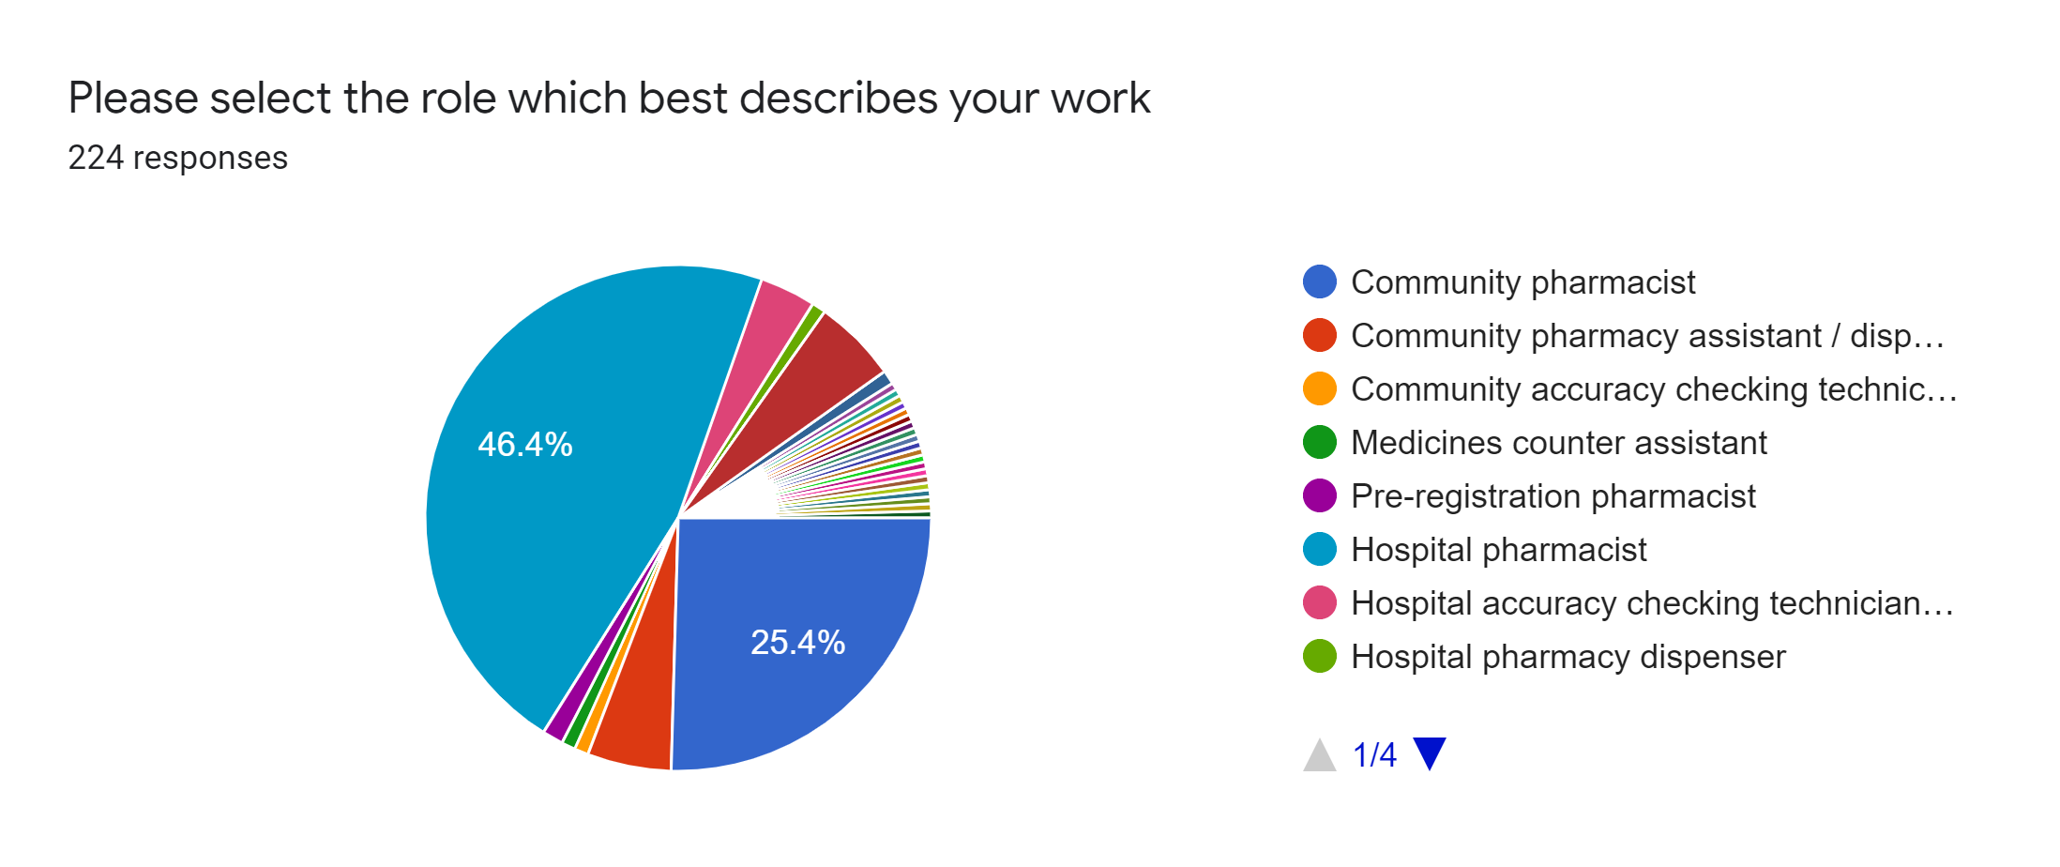
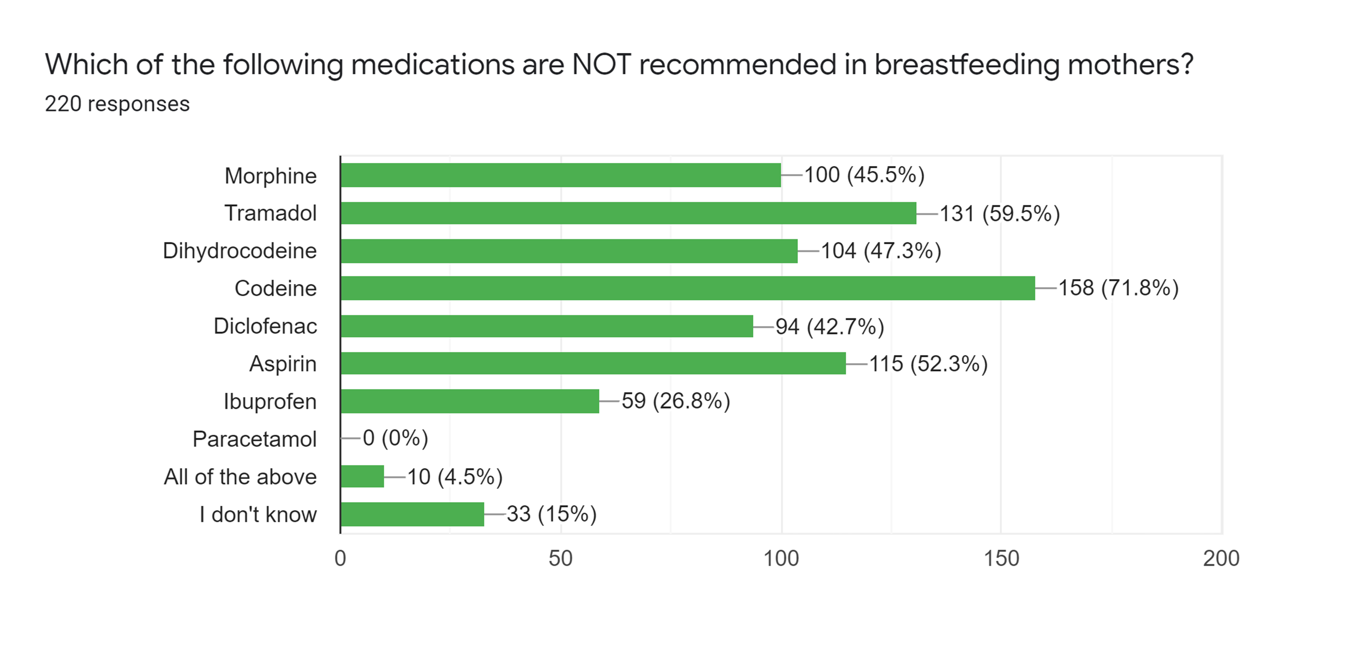
Assessing Pharmacy Confidence in the Safety of Drugs in Lactation:
Scope for Further Learning and Multi-Disciplinary Education
Jessica Jones Mpharm MRPharmS

Slide 4
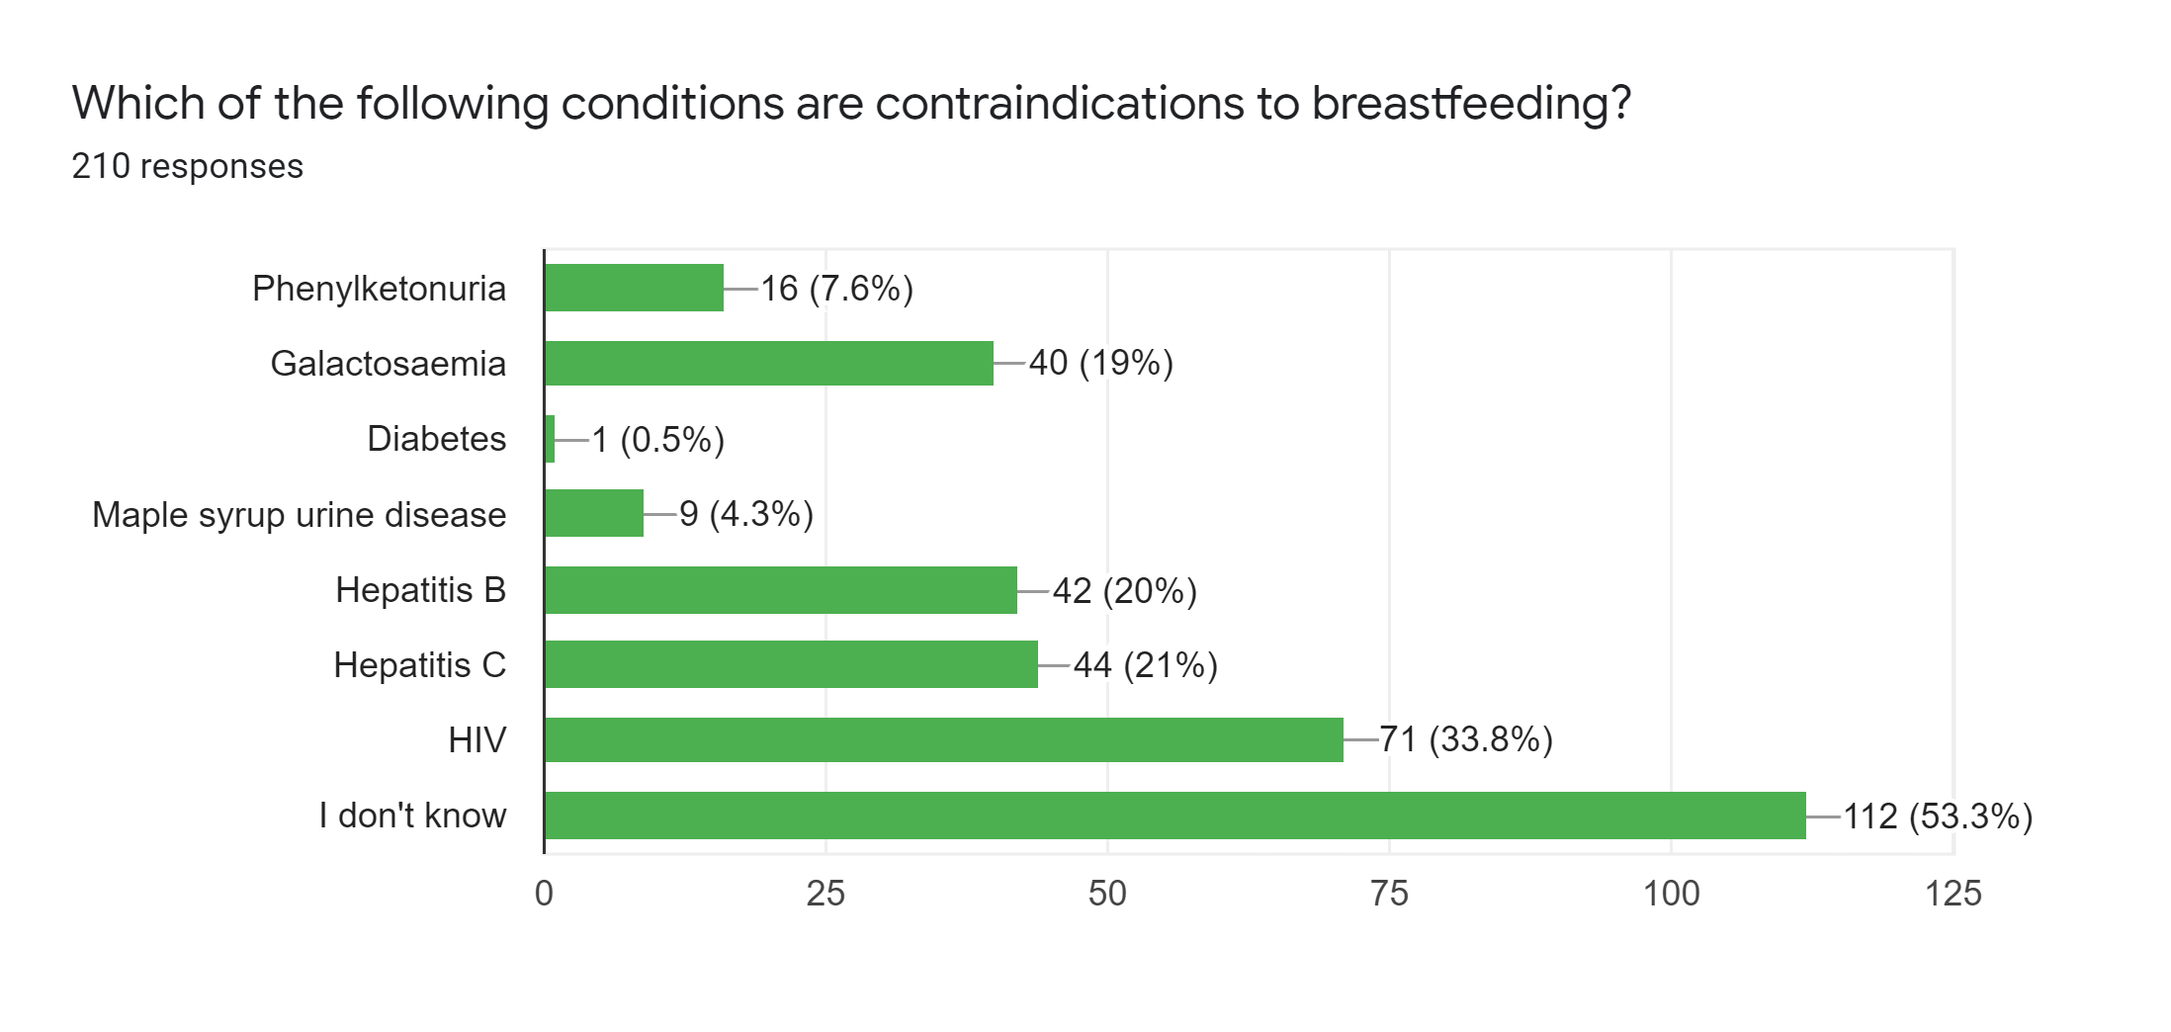
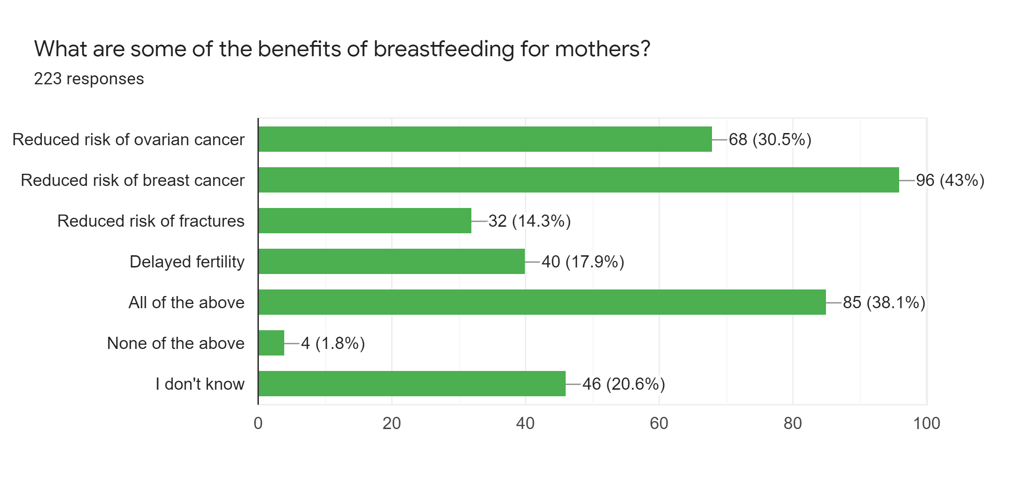
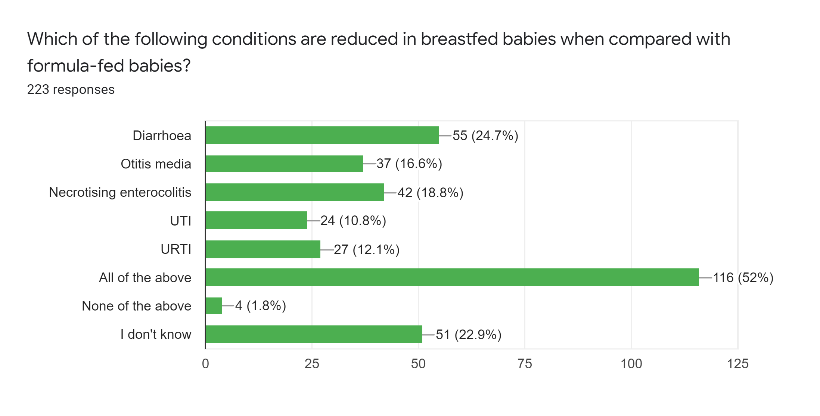
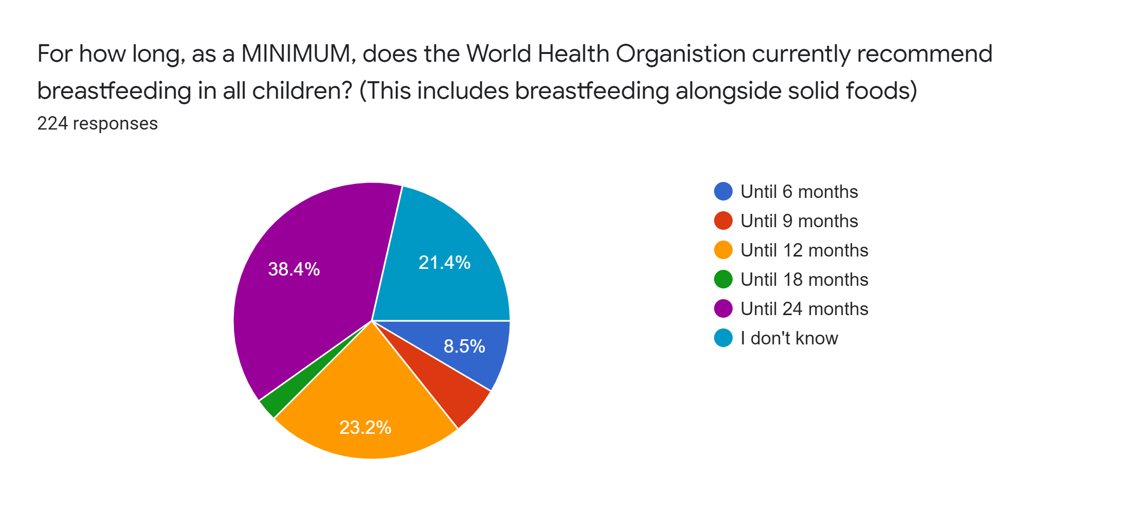
Assessing Pharmacy Confidence in the Safety of Drugs in Lactation:
Scope for Further Learning and Multi-Disciplinary Education
Jessica Jones Mpharm MRPharmS

Slide 5
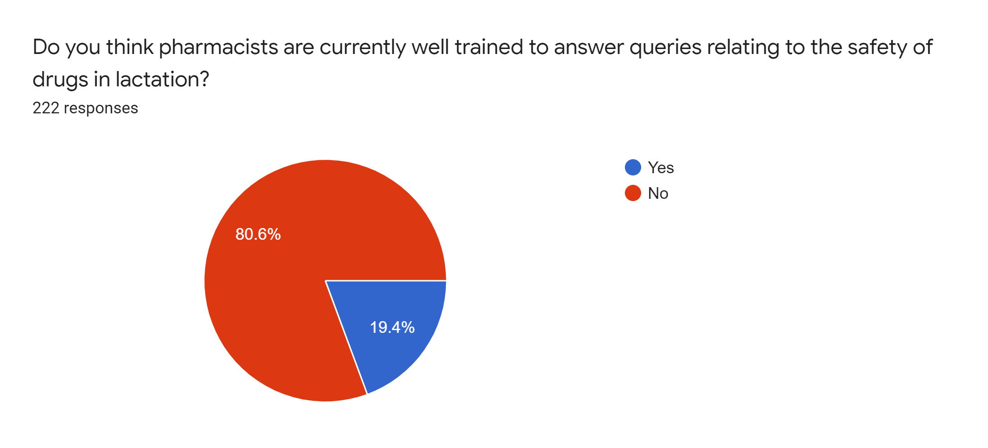
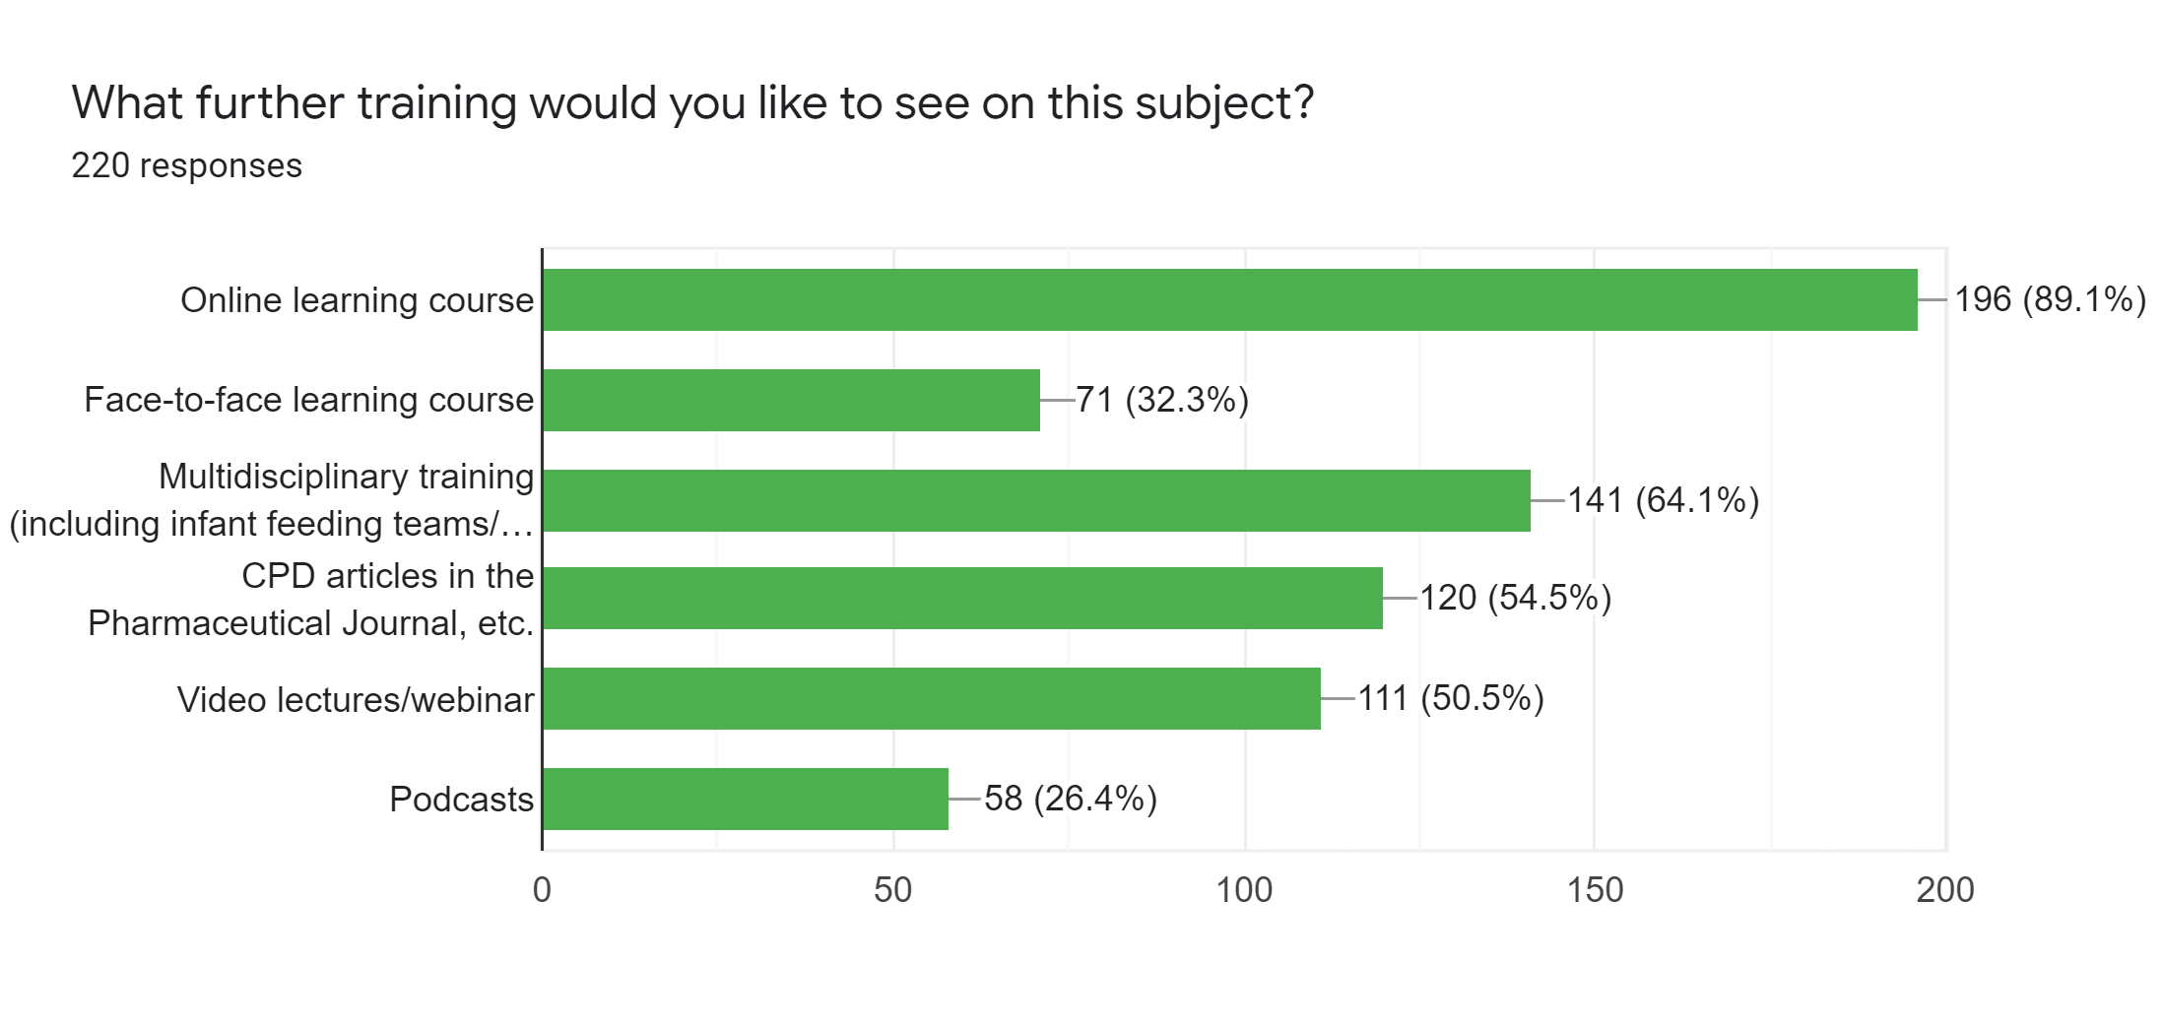
Assessing Pharmacy Confidence in the Safety of Drugs in Lactation:
Scope for Further Learning and Multi-Disciplinary Education
Jessica Jones Mpharm MRPharmS

Slide 6
With special thanks to: Dr Wendy Jones (MBE PhD MPharmS) The Breastfeeding Network Volunteer Drugs in Breastmilk Pharmacists: Gayle Anderson Lottie Ayres Abigail McDougall Sam Morris Jenny Oliphant Reena Patel Nadine Revell Sarah Robinson Zoe Roseblade & Phillipa Winter jessi.jones@nhs.net

