Slide 1
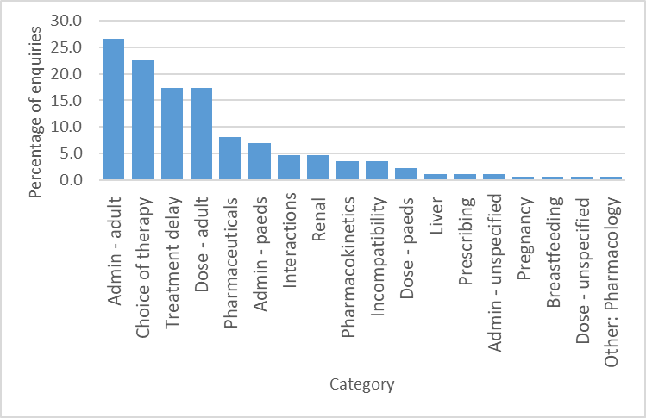
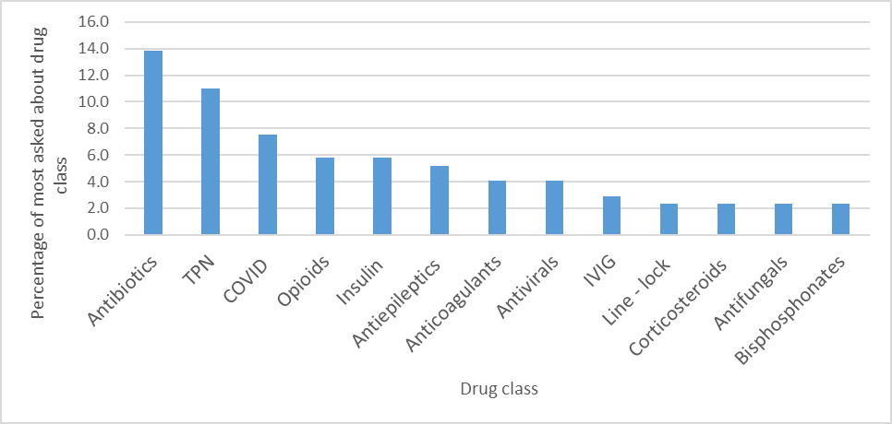
Medicines advice out-of-hours - supporting the on-call workforce to make safe decisions
Authors
Trainee pharmacist: Sally Badin, Supervising pharmacists: Angela Badiani, Lauren Williams
University Hospital Southampton NHS Trust
INTRODUCTION
Medicines advice is an integral part of the NHS pharmacy on-call service which is typically delivered by newly qualified staff.¹ Thorough training for this role is crucial prior to starting, to ensure that pharmacists are equipped with the knowledge and skills to solve clinical problems that may arise out-of-hours. At UHS, pharmacists undergo a structured face-to-face teaching programme and complete a module on the Medicines Learning Portal before starting an on-call role. This service evaluation study aimed to understand the type of medicines advice enquiries received out-of-hours, the information resources used, and answers given to ensure that the teaching remains relevant and that our pharmacists are trained to undertake this role effectively and safely.
Figure 1: Percentage of categories of enquiries received in the 3-month-period.
OBJECTIVES
METHODOLOGY
To identify a retrospective sample of medicines advice enquiries answered out-of-hours.
To record different enquiry categories (e.g. drug interactions, adverse effects etc.) and patient types (e.g. patients with renal disease, children etc.).
To identify whether there are any medicines that are frequently asked about.
To determine whether the advice given was correct.
Clinical enquires entered out-of-hours into the “On Call Manager’’ database at UHS for the period of July - September 2022 were reviewed retrospectively. The data were sorted using Microsoft Excel into enquiry category, name of medicine in question, and drug therapeutic class. The answers were peer reviewed by an experienced Medicines Advice pharmacist to ensure accurate advice was given. This study did not require ethics approval.
Figure 2: Percentage of most asked about drug classes received in the 3- month-period. Only the 19 most common drug classes have been included.
EXAMPLE ENQUIRIES
Administration of carbamazepine for patients who were nil by mouth. The pharmacist advised a switch to the equivalent dose of suppositories.
Compatibility of ketamine, TPN, metronidazole, meropenem and AmBisome via a double lumen Hickman line. The pharmacist advised to not administer using the same line as unsuitable.
Administration of praziquantel for hydatid disease caused by tapeworm in a patient with an NG tube. The pharmacist advised on possible administration and referred to appropriate team.
RESULTS
CONCLUSION
A total of 709 calls were received during the data collection period, with 173 (24.4%) of these calls requiring medicines advice.
Most of the calls related to administration advice in adults (n=46, 26.6%), followed by choice of therapy (n=39, 22.5%), managing delays in patients receiving treatment (n=30, 17.3%), adult dosing (n=30, 17.3%), and pharmaceutical issues (n=14, 8.1% )(Figure 1).
Antibiotics were the most asked about group of medicines (n=24, 13.9%) (Figure 2), with gentamicin, vancomycin and metronidazole being mentioned in 4 calls each.
Unfortunately, 36.4% (n= 63) of calls received were unable to be peer reviewed due to a lack of documentation or unclear advice. Of the calls that were peer reviewed, only one (0.6%) was considered inappropriate advice.
CONCLUSION
Over the 3-month study period, one quarter of calls received by the UHS on-call pharmacy team required the provision of medicines advice. This reinforces the importance of teaching the core aspects of clinical problem solving to pharmacists before undertaking an on-call role. Most calls related to administering medicines in adults, choosing medicines, with antibiotics, TPN and COVID treatments being the most common therapeutic classes. The advice given was judged appropriate in most cases. The medicines advice on-call teaching programme will be reviewed to ensure that the content remains comprehensive and relevant.
REFERENCE
Cheeseman MP, Rutter, P. On-call hospital pharmacy services in NHS England: service provision and documentation of medicines advice calls. Eur J Hosp Pharm 2016;23:11-15.
Southampton Pharmacy Research Centre

