Slide 1
Expectations and Perceptions of a Medicines Helpline Service: What do Patients Want?
Sophie Carter, Leeds Medicines Advice Service
Leeds Teaching Hospitals NHS Trust

Slide 2
BACKGROUND
Leeds Teaching Hospital’s Medicines Advice Service completes approximately 5-10 medicines helpline queries per week from members of the public.
Our medicines advice team felt this is a small number, considering it is one of the largest teaching hospitals in Europe, with approximately 2,500 inpatient beds.¹
A recent systematic review of medicines information services stated that further qualitative research is needed to establish what the public want, and whether services could be improved to better suit their needs.²
We decided there was a need to determine patients’ awareness of our helpline, and how we could make it more patient-focused, so invited patients and/or carers to discuss their views.
References: National Health Service (NHS). NHS UK, Leeds Teaching Hospitals NHS Trust Overview [Internet]. NHS UK [updated 26 June 2019]. Available from: https://www.nhs.uk/Services/Trusts/Overview/DefaultView.aspx?id=1373 (accessed 6 July 2020). Williams M, Jordan A, Scott J, Jones MD. A systematic review examining the effectiveness of medicines information services for patients and the general public. Int J Pharm Pract 2020 [online]; 28(1): 26-40. doi:10.1111/ijpp.12571 (accessed 6 July 2020).

Slide 3
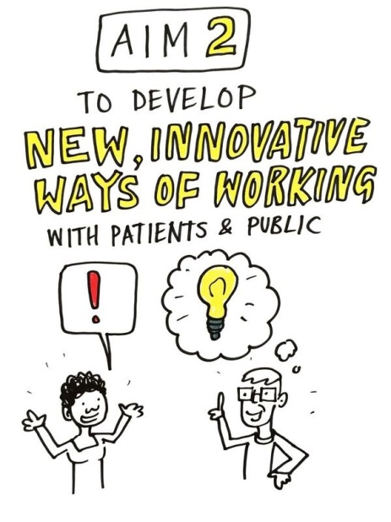
METHOD
Five semi-structured open questions were prepared, which covered: current approaches to resolving medicines queries after discharge, awareness of the medicines helpline, expectations of the service, perceived usefulness and concerns, and service advertising.
A focus group of expert patients and/or carers attended a workshop at Leeds Teaching Hospitals to openly discuss their views on the above topics.
The workshop was audio-recorded and hand-written notes were taken by the facilitator. Participants’ responses were thematically analysed and the key findings summarised.
Participants were split into 2 small groups. They had 10-15 minutes per question to discuss their responses and record key opinions on paper.

Slide 4
RESULTS
Must be easy to contact; 24/7 access wanted
Rapid responses and realistic timelines wanted
All participants (n=8) were unaware of the medicines helpline.
Contact routes currently used for resolving queries were:
Discharge ward
GP
Pharmacist (GP surgery/ community pharmacy)
Specialist nurse helplines
NHS 111
Internet
Opinions on the best method varied depending on individual experiences, but there was consensus that a medicines helpline would be useful.
Methods for better publicising of the helpline were suggested and encouraged by the participants.
Timeliness
Potential for quicker answers; could relieve pressure on other services
Many contact routes suggested; but noted resource limitations
Collaborative service
Difficulties if there are communication barriers
Safeguard – may prevent A&E admissions
Helpline
Expectations & Perceptions 3 key themes
1st port of call or 2nd opinion
Personalised, caring, reassuring manner
Consent & confidentiality important
Specialist professionals
Patient- friendly
No jargon; use plain English
Accurate responses from qualified pharmacists with trusted knowledge
Less intimidating/
stressful/time-pressured than asking at doctor’s
Concerns: not feeling understood/ not understanding response

Slide 5
DISCUSSION & FUTURE
In line with the findings of Williams et al,³ a medicines helpline is perceived to be a valuable specialist service for medicines-related questions, if it is: well-advertised, easily accessible, and timely, reassuring responses are received.
We are looking to improve the advertisement of our patient helpline via various methods in both secondary care and primary care locations, and public spaces, as well as updating our business card in accordance with comments from participants.
We will review numbers of patient enquiries in 6-12 months and hope to see an increase.
We will strive to ensure we have a patient-friendly, reassuring manner and use language that is easy for patients to understand both over the phone and in written responses.
We have reviewed and extended our helpline opening times in line with comments on accessibility and timeliness of responses and will continue to deal with queries as promptly as possible, giving appropriate timelines where necessary.
References:
Williams M, Jordan A, Scott J, Jones MD. Service users’ experiences of contacting NHS patient medicines helpline services: a qualitative study. BMJ Open 2020 [online]; 10: e036326. doi: 10.1136/bmjopen-2019-036326 (accessed 6 July 2020).

